Slide 1


Conscious
Advertising
Network
#TogetherWeCAN
consciousadnetwork.com
@consciousadnet

Slide 2



Zenith forecast global adspend to grow by 4.6% this year to reach $639bn. Half of all global adspend will be online by 2021.

Slide 3
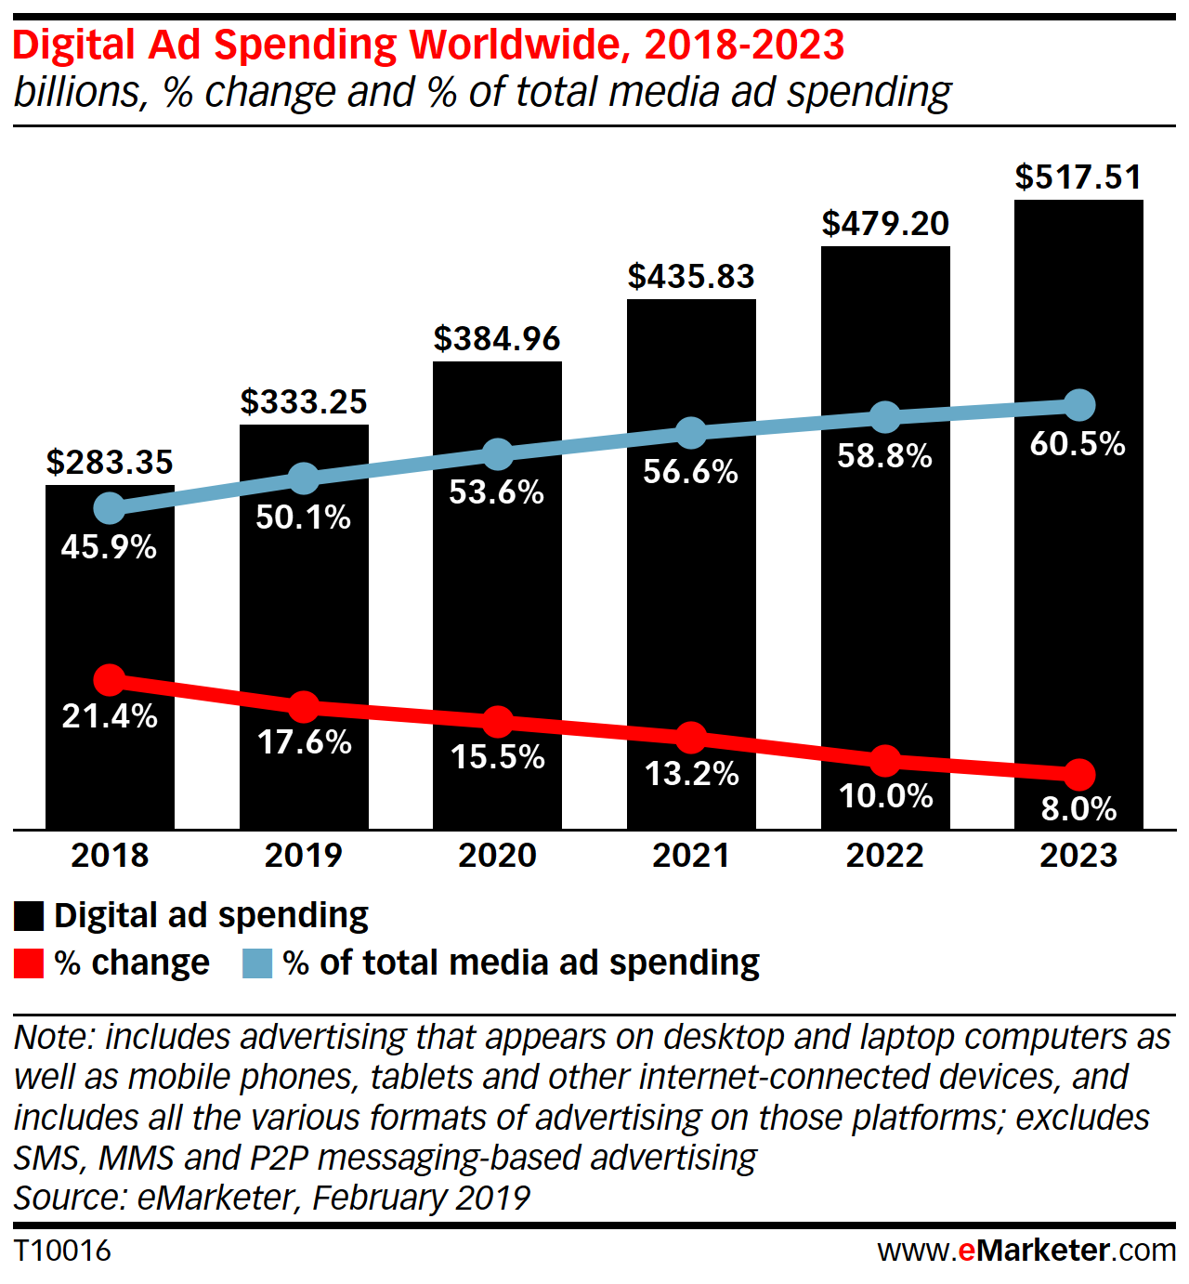
Conscious
Advertising
Network

Slide 4
Who are the Conscious
Advertising
Network?

Slide 5

























Notes:
VOLUNTEER. NON PROFIT.

Slide 6
MISSION
To help the ethics catch up with the technology of modern advertising

Slide 7






6 MANIFESTOS
FAKE NEWS
HATE SPEECH
ANTI-FRAUD
DIVERSITY, INCLUSION AND EQUALITY
CHILDREN’S WELLBEING
INFORMED CONSENT
Notes:
WE SUPPORT ANTI-FRAUD INITIATIVES
The whole digital advertising eco-system needs to take responsibility and be accountable for
minimizing ad-frauds across their relationships
WE SUPPORT DIVERISTY, INCLUSION AND EQUALITY
The content we create must be as diverse as the society we serve. To achieve this, we must
ensure that diverse teams make the diverse work that speaks to diverse audiences
WE SUPPORT INFORMED CONSENT IN THE USE OF DATA FOR ADVERTISING
We believe in creating greater clarity, respect and transparency around how personal data is
used, what people receive in return and options for users to tailor their online experience
WE SUPPORT THE FIGHT AGAINST FAKE NEWS
Advertisers must take the responsibility to ensure they don’t fund channels that fund fake
news, click-bait and any intentionally misleading content
WE SUPPORT ACTIONS THAT COUNTER HATE SPEECH
Advertising funds hate speech inadvertently. We must actively avoid media outlets that fuel
hatred on the grounds of race, religion, nationality, sexuality, gender, disability or any other
group characteristic
WE SUPPORT THE WELLBEING OF CHILDREN
Advertising to children should be age appropriate, promote positive messaging and values
and avoid glamourizing negative behaviours

Slide 8
GOAL
For all clients to incorporate the principles of the manifestos into all agency briefs and RFPs

Slide 9
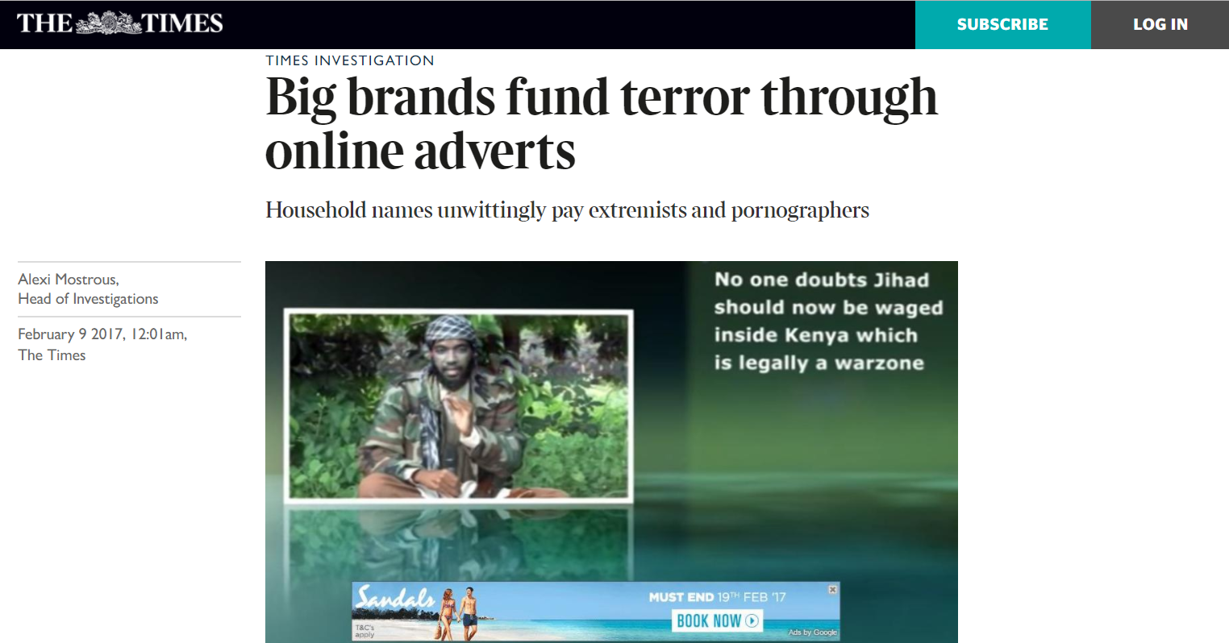

Slide 10
Fake news, racism, sexism, terrorists spreading messages of hate, toxic content directed at children - parts of the internet we have is a million miles from where we thought it would take us
Keith Weed, President Advertising Association
12th February 2018

Slide 11
HATE SPEECH

Slide 12
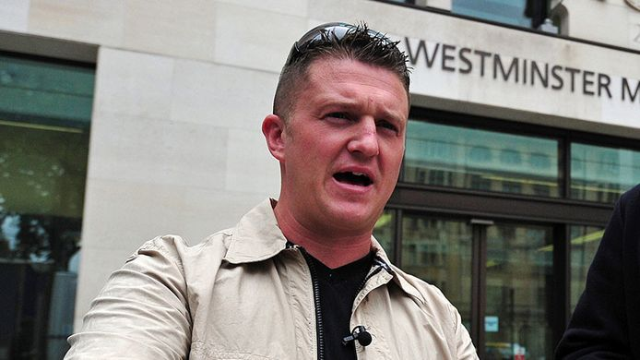

Slide 13
‘Muslims are filthy scumbags’
Jan 2019
‘Make war on muslims’
Jan 2019
‘If you’re a journalist and you think your office or your home is a safe space …. It’s not’

Slide 14
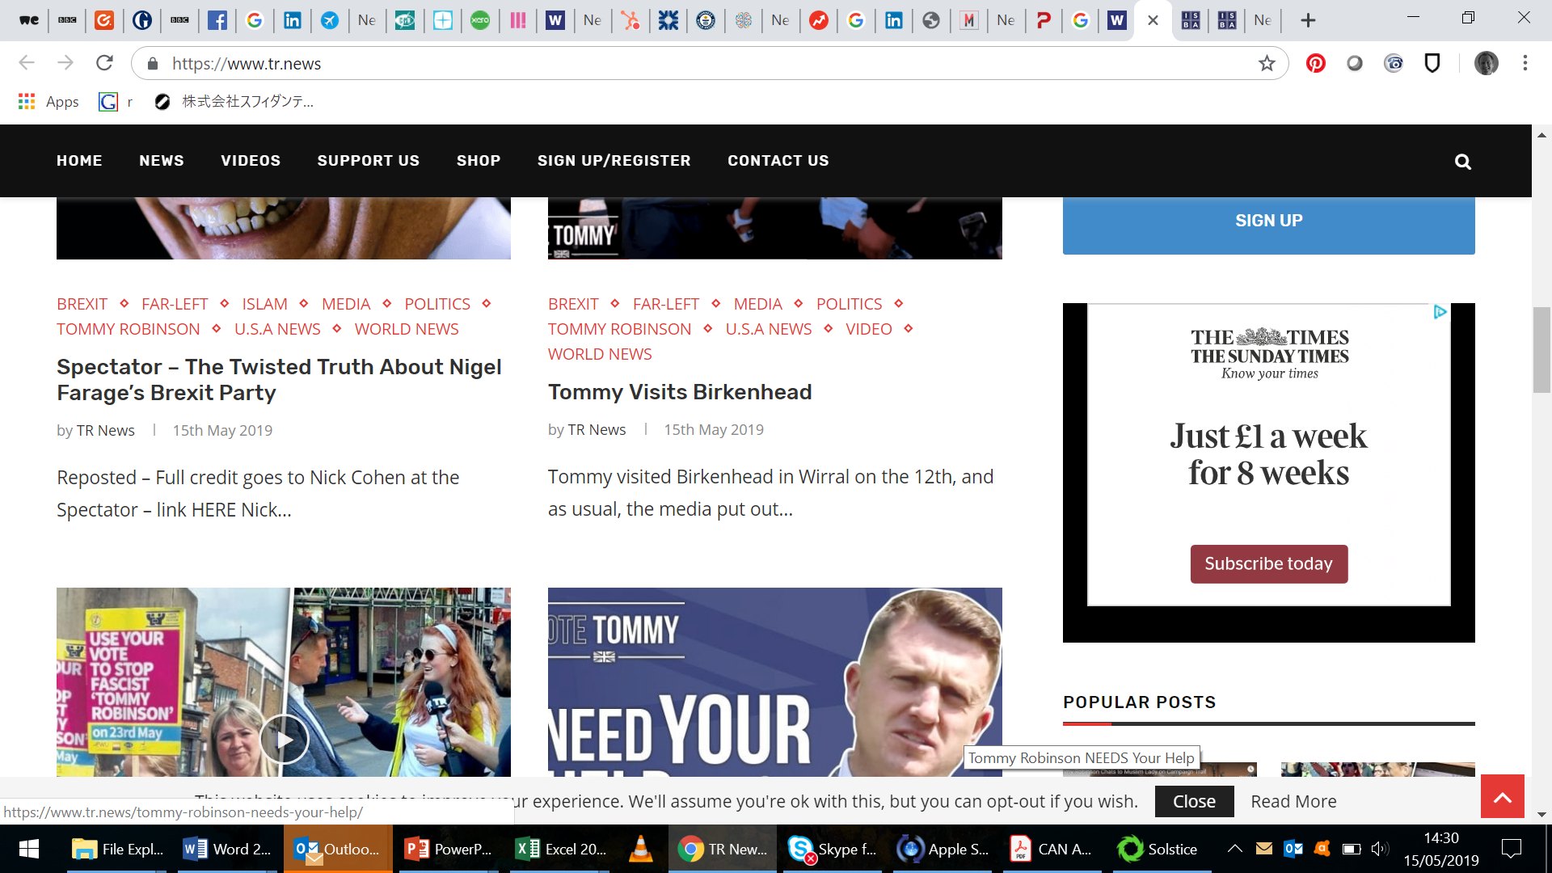

Slide 15
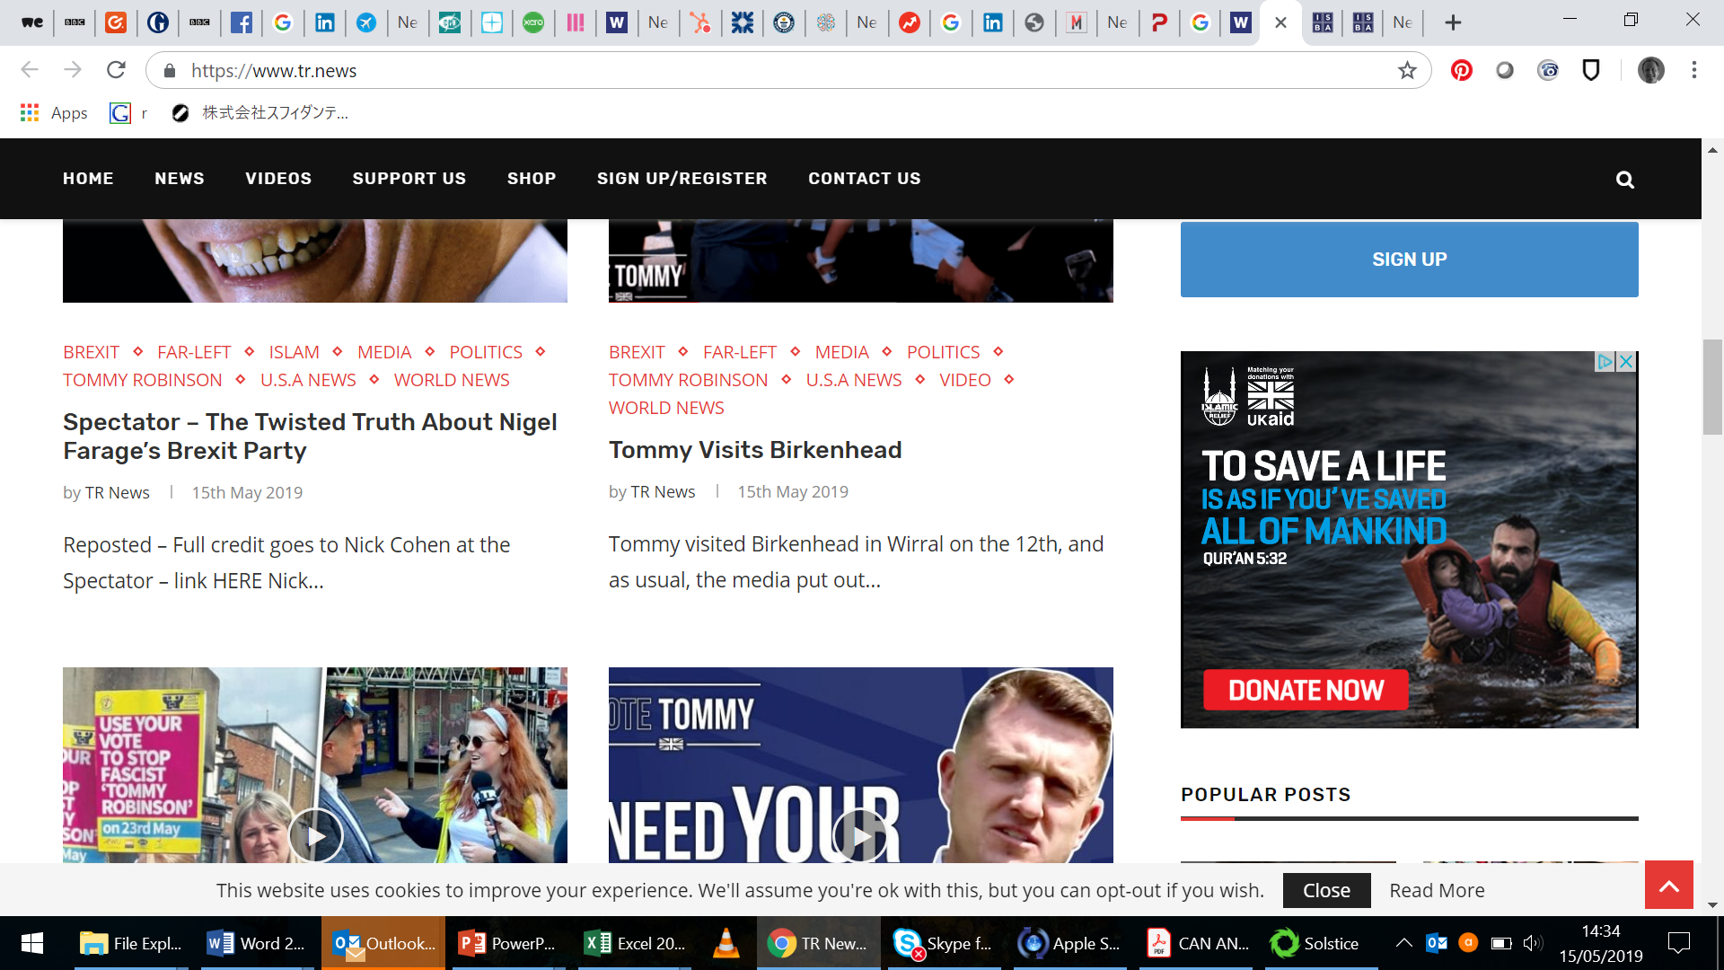

Slide 16
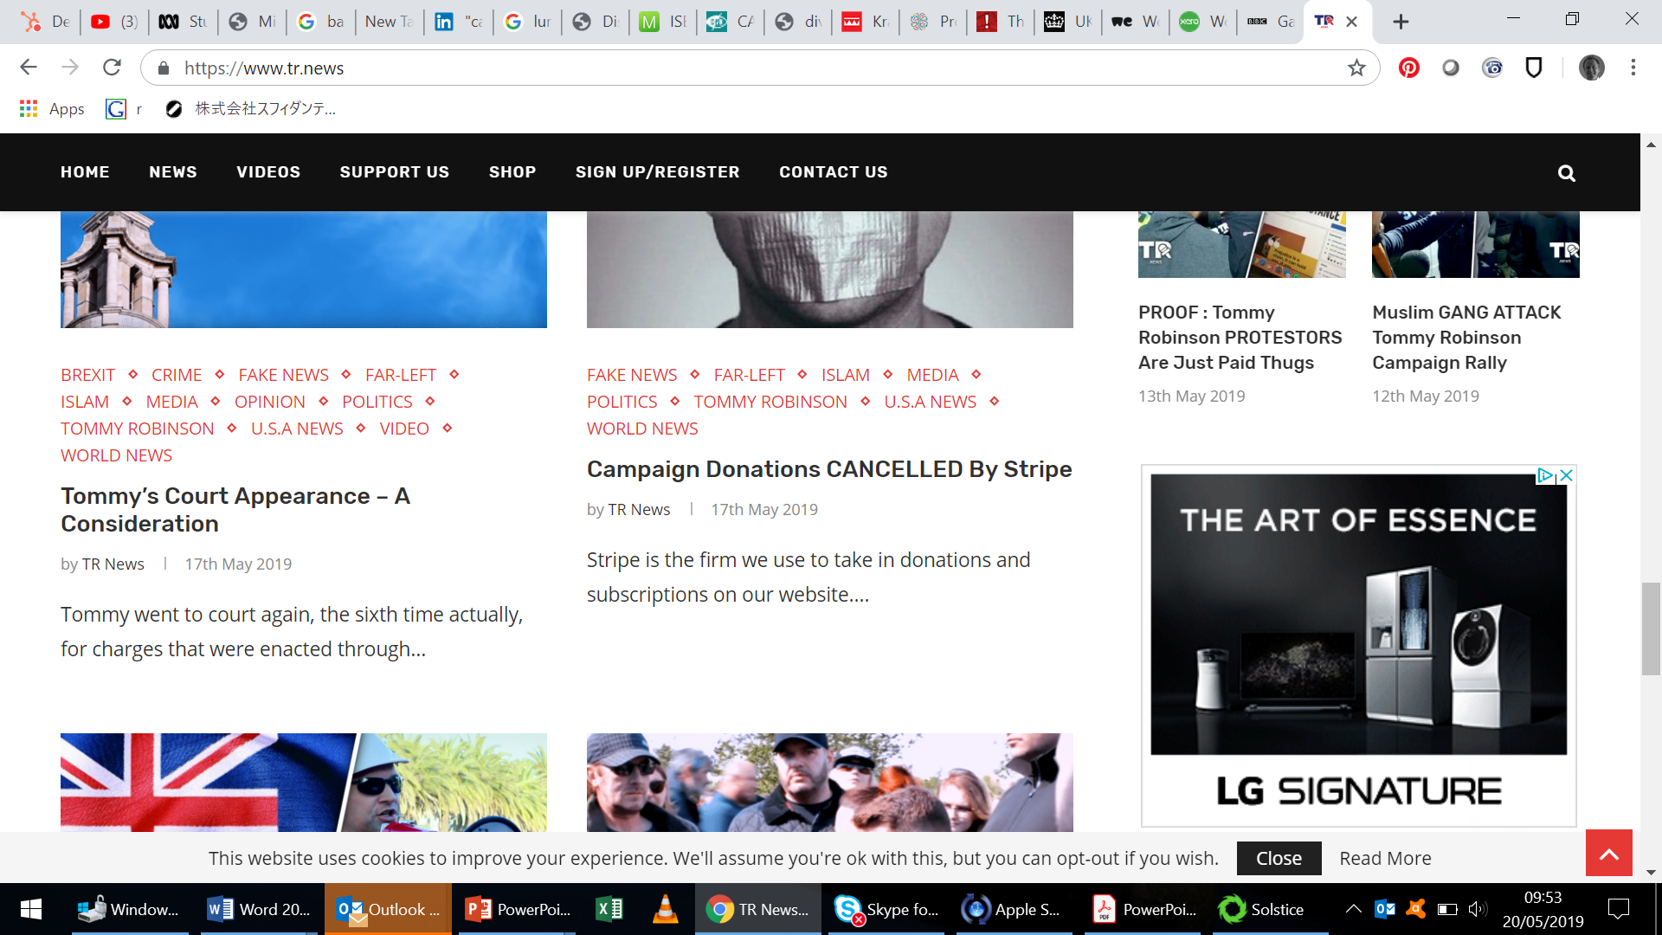

Slide 17
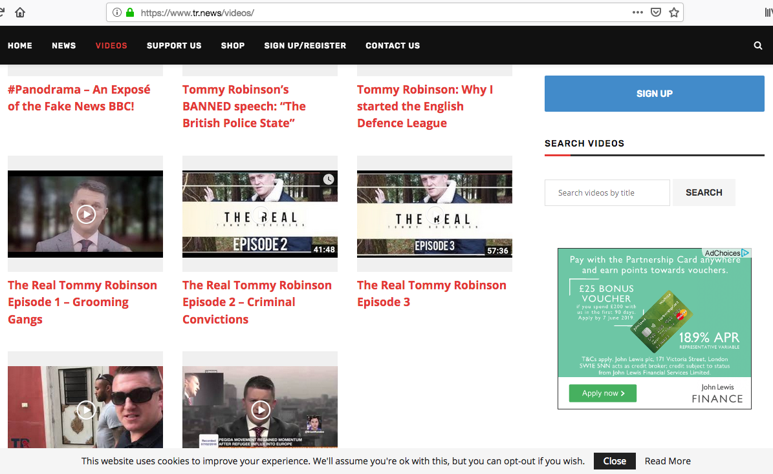

Slide 18
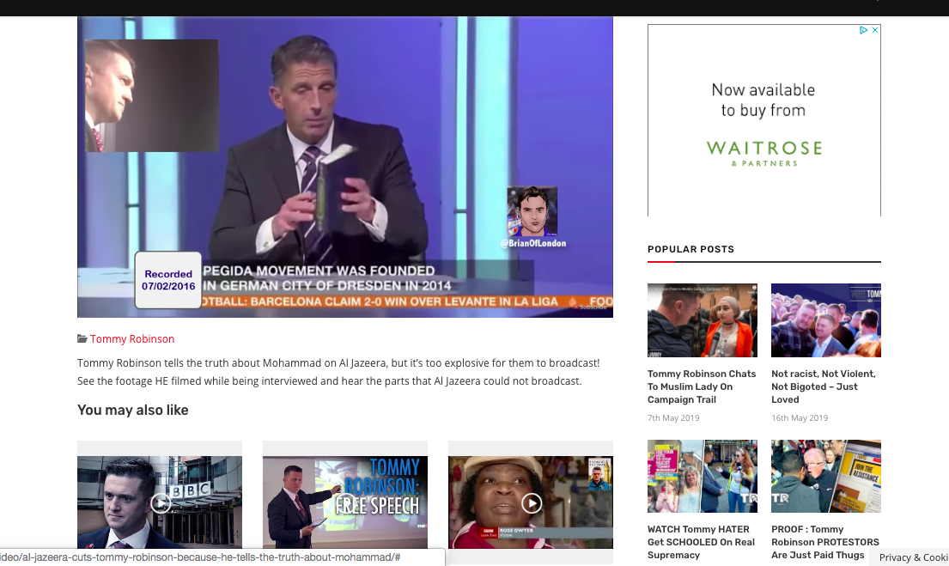

Slide 19
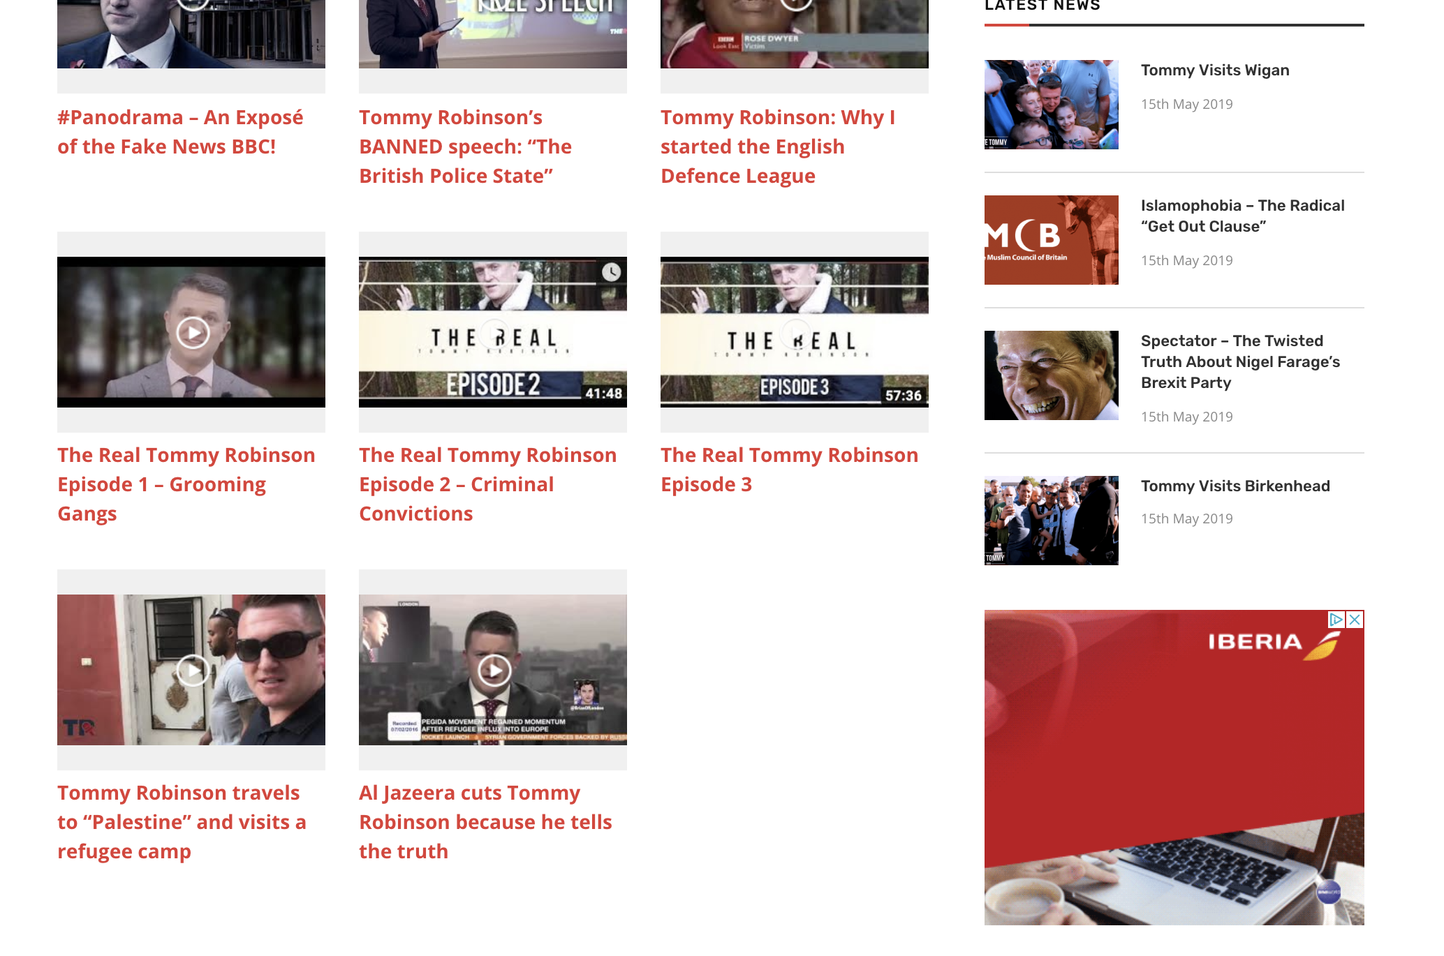

Slide 20
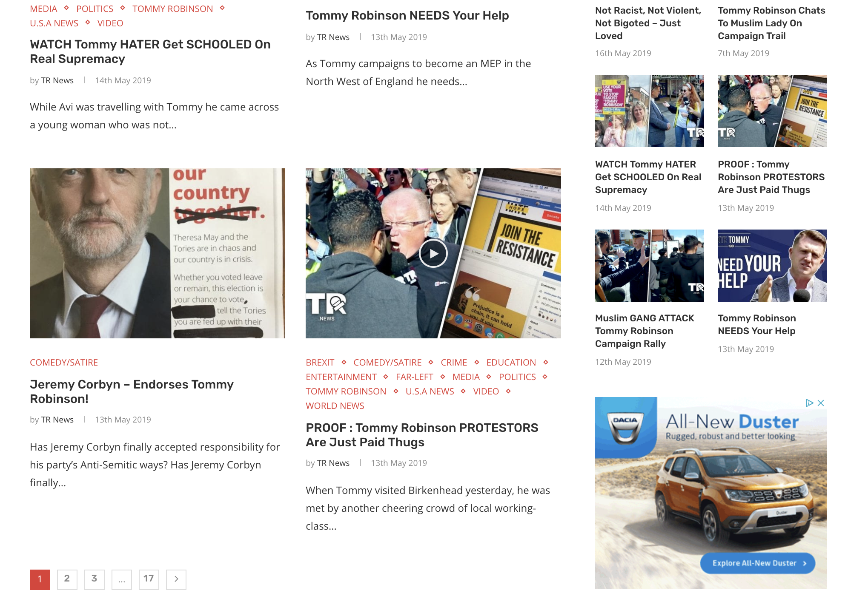

Slide 21
Christchurch Terrorist -
Generation Identity

Slide 22
‘Well-dressed, highly educated and from respectable families. Why this new British far-Right group is the most sinister and dangerous yet’
The Daily Mail

Slide 23
Generation Identity group — known as Identitarian Movement Austria held a protest against “The Great Replacement” in Vienna, calling for “remigration” and “de-Islamization” a week after the Christchurch Terrorist atrocity.
Notes:
In a manual called “The Art of Redpilling” Sellner’s movement provides instructions for step-by-step far-right radicalization. It recommends leveraging widespread grievances related to free speech or gender equality as a starting point, before gradually introducing new recruits to identitarian ideologies: “You sow the soft redpill seeds and then you water them constantly. An honest question to start with, a news piece here, an email there, and in the evening an anecdote over beer.”

Slide 24
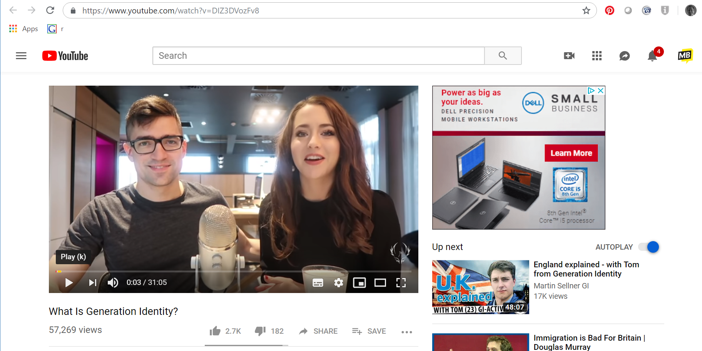
Advertising
Network

Slide 25
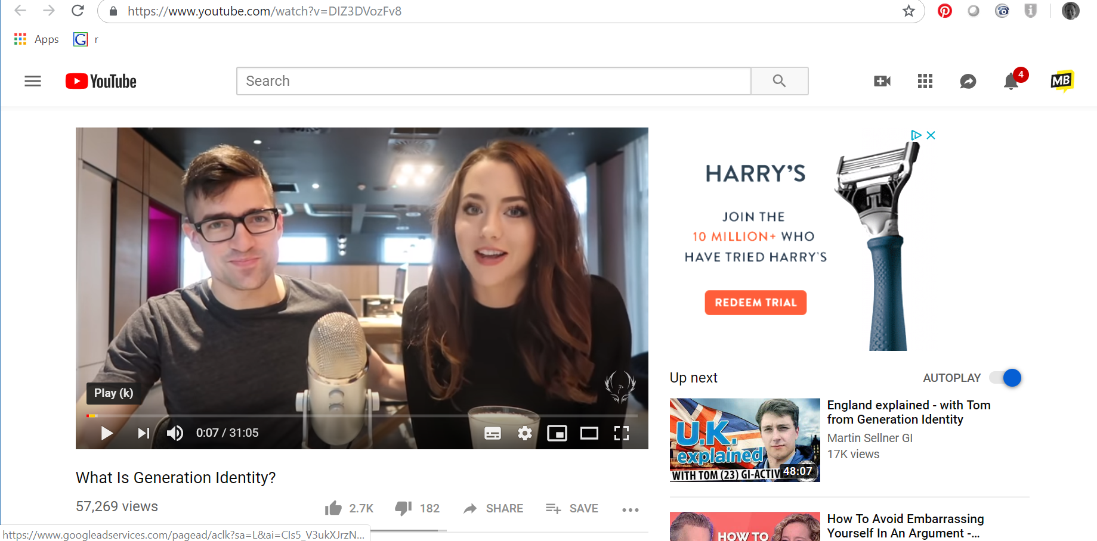
Advertising
Network

Slide 26
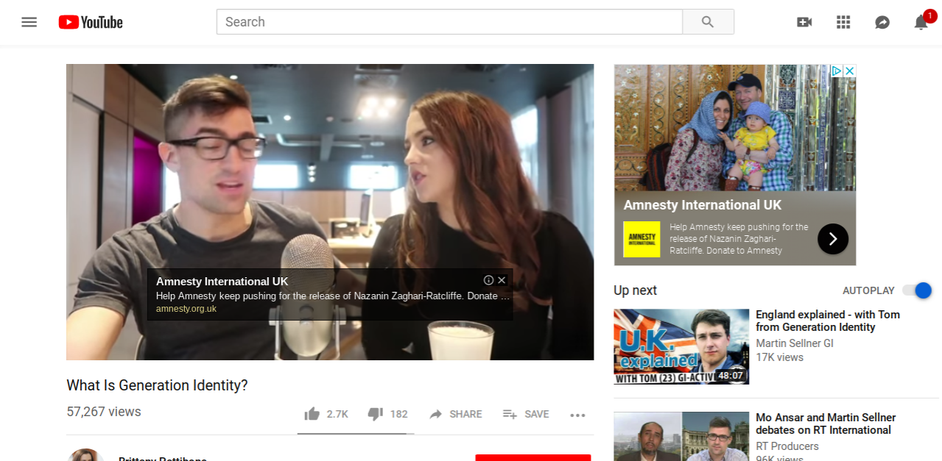
Advertising
Network

Slide 27
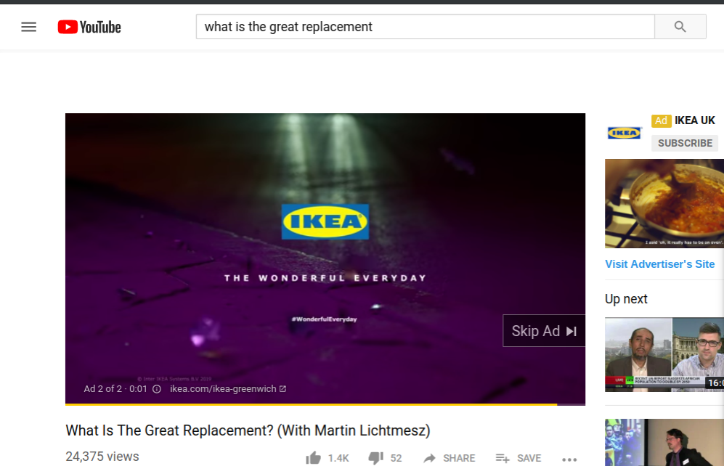
Advertising
Network

Slide 28
FAKE NEWS

Slide 29
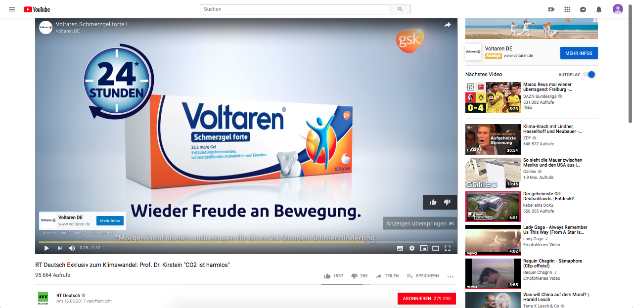

Slide 30
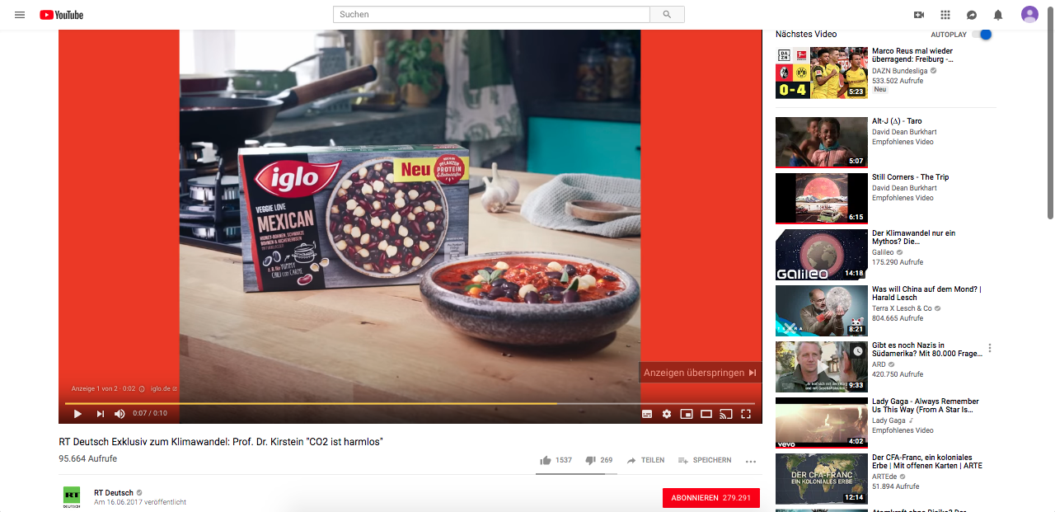

Slide 31
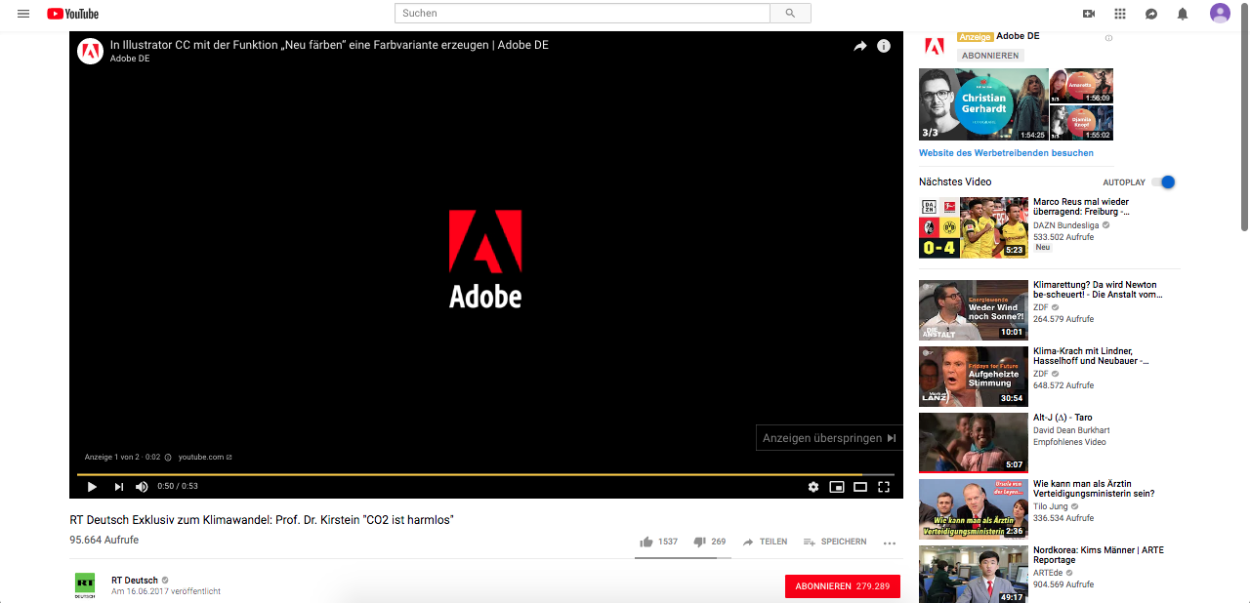

Slide 32
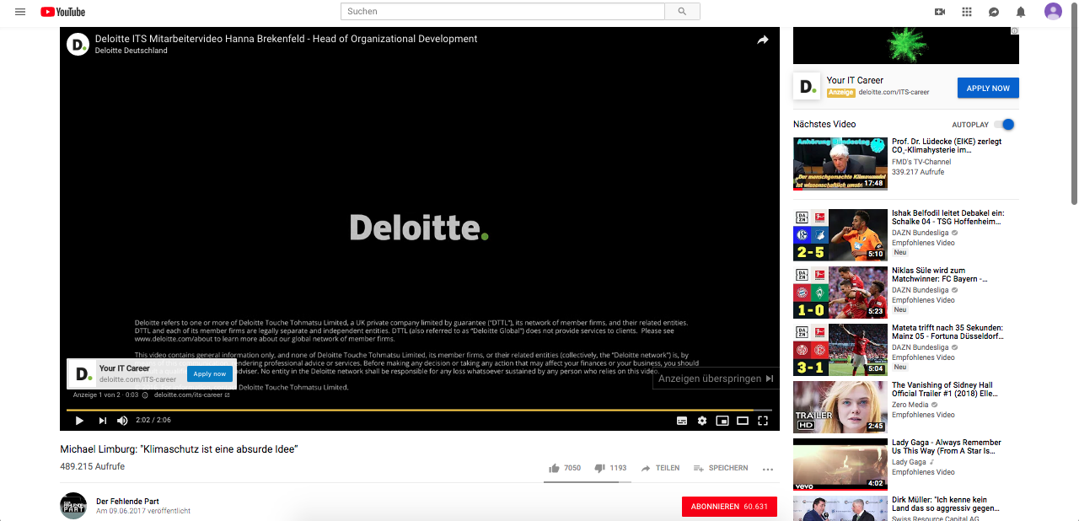

Slide 33
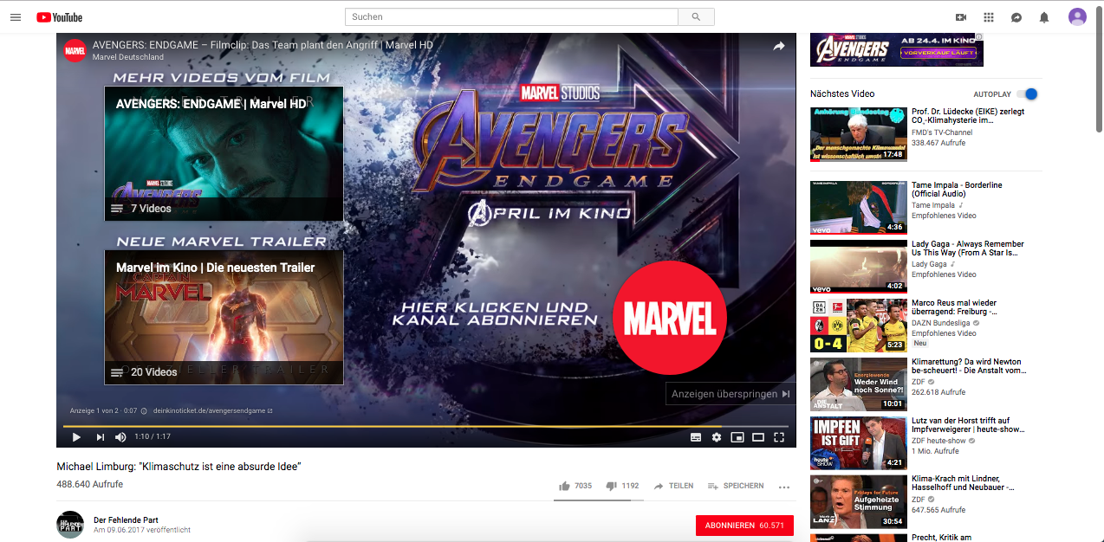

Slide 34
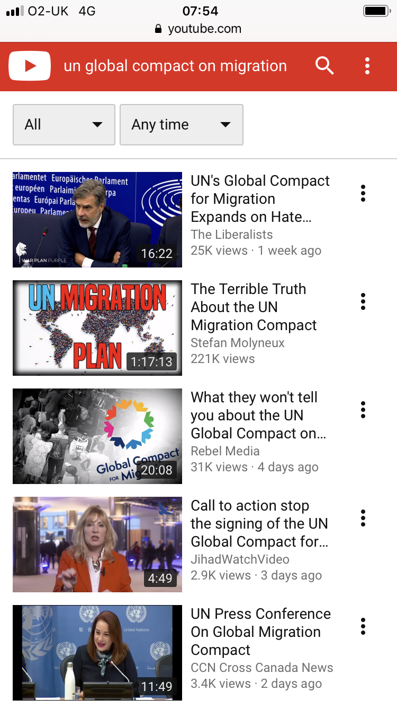
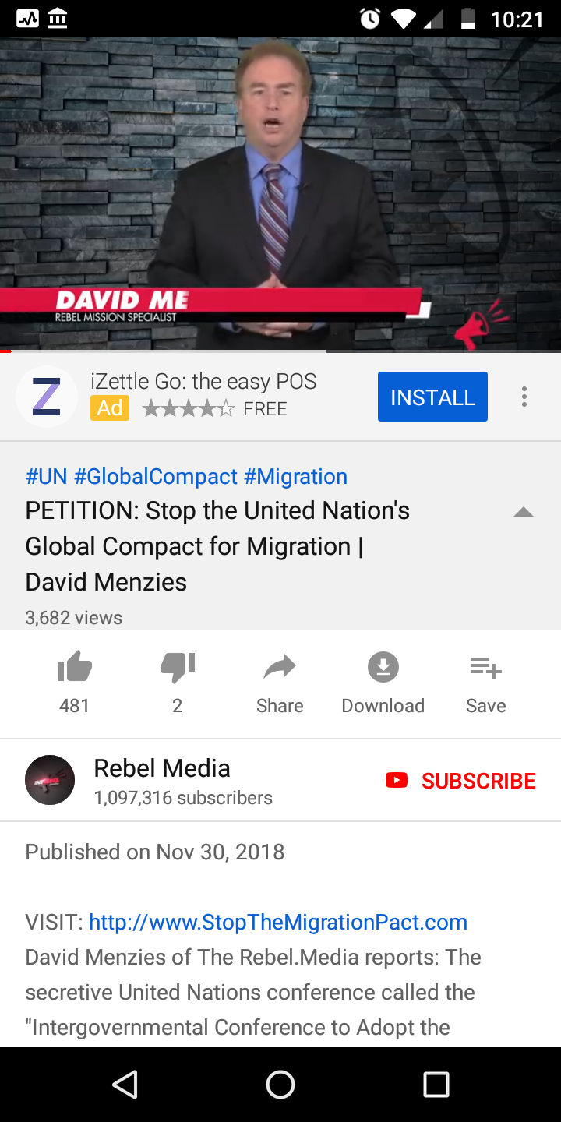
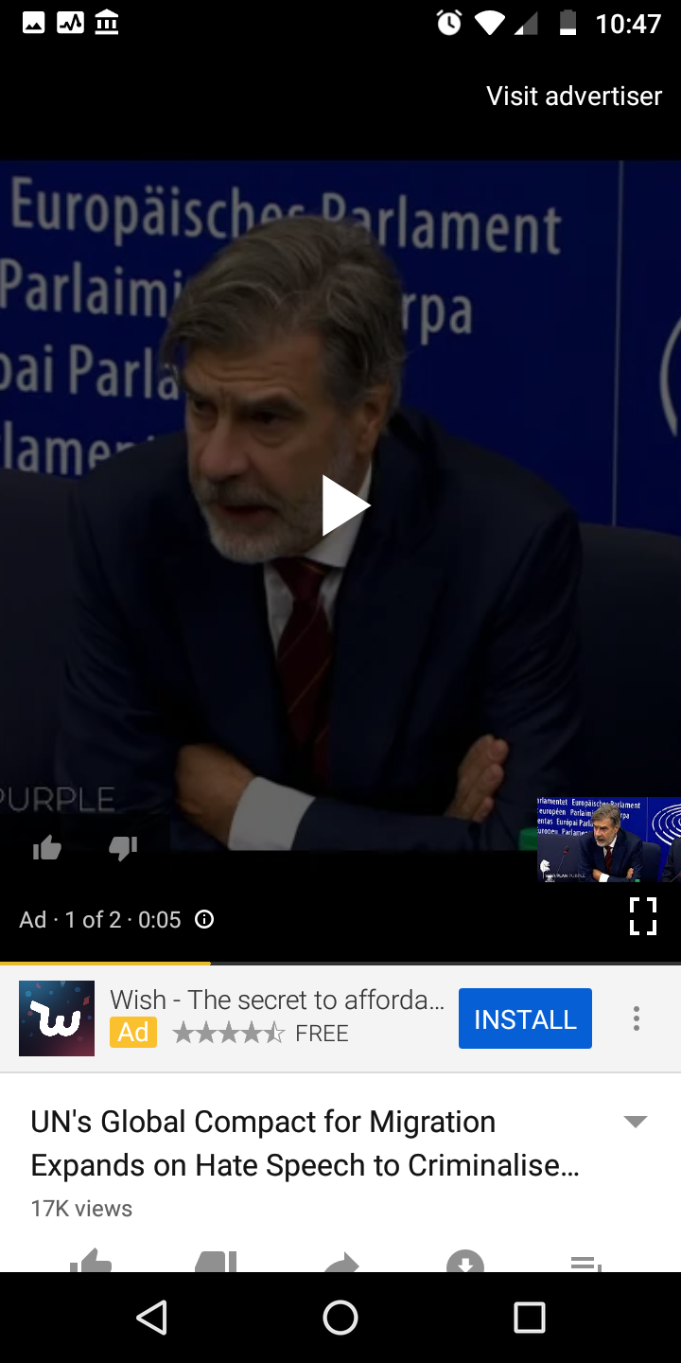
Notes:
Alphabet ad revenue up 20% to $28.95 billion in Q3 2018.

Slide 35
Diversity in Content

Slide 36

diverse teams = diverse work = diverse audiences

Slide 37
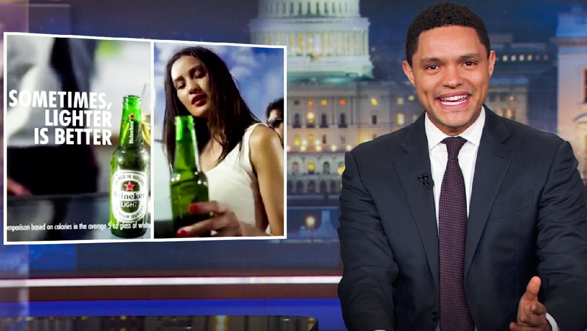

Slide 38
GOAL

Slide 39
GOAL
For all clients to incorporate the principles of the manifestos into all agency briefs and RFPs

Slide 40
WHAT WE ARE ASKING BUSINESS TO DO
Sign up
2. Report in 6 months answering 3 questions:
How many people client and agency side have you trained?
How many RFPs and Briefs have included the principles of the manifestos?
Do you have a better ethical framework in your agency ecosystem than 6 months ago?

Slide 41
Work with us to make CAN obsolete

Slide 42
Conscious
Advertising
Network
#TogetherWeCAN
consciousadnetwork.com
@consciousadnet

