Slide 1
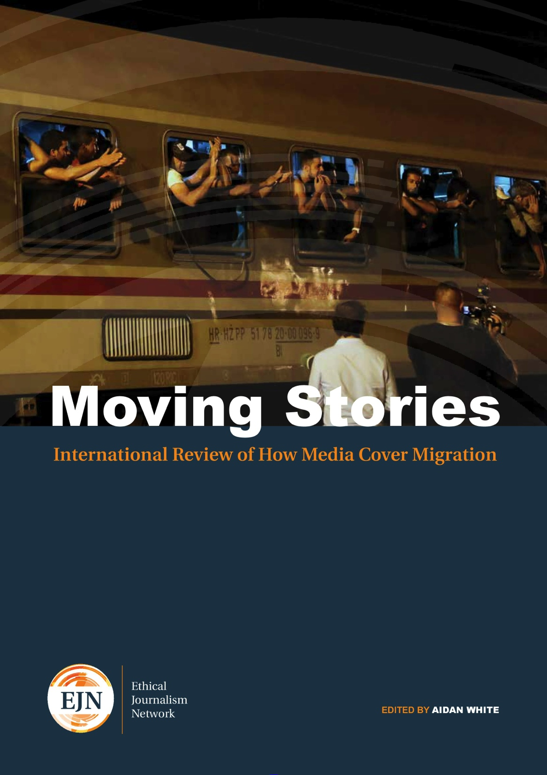
Aidan White, Director

Slide 2
Who we are
A coalition of media professional groups from around the world aiming to strengthen the craft of journalism by promoting ethics, good governance and media self-regulation in the digital age
www.ethicaljournalismnetwork.org

Slide 3
Countries Covered:
Australia, Brazil, China, Bulgaria, Gambia, India, Italy, Lebanon, Nepal, Mexico, Great Britain, United States, South Africa, Turkey and European Union

Slide 4
Aim of Report:
To review media coverage of migration in 2015 and the biggest movement of people across borders since the Second World War. This is a review of coverage from a journalistic not an academic perspective.

Slide 5
Findings: The Good, the Bad and the Ugly
Much coverage has been informed, factual and laced with humanity, but in many countries similar problems arise:
Political Propaganda and hate speech
Media Weakness
Ethical Challenges
Numbers v Humanity

Slide 6
Political Propaganda
In Europe and the United States political leaders use the migrant and refugee crisis to manipulate the media message.
Too often media accept the outrageous statements of political and community leaders as newsworthy without reporting them in context or challenging the impact of hate speech on migrants or on marginalised groups.

Slide 7
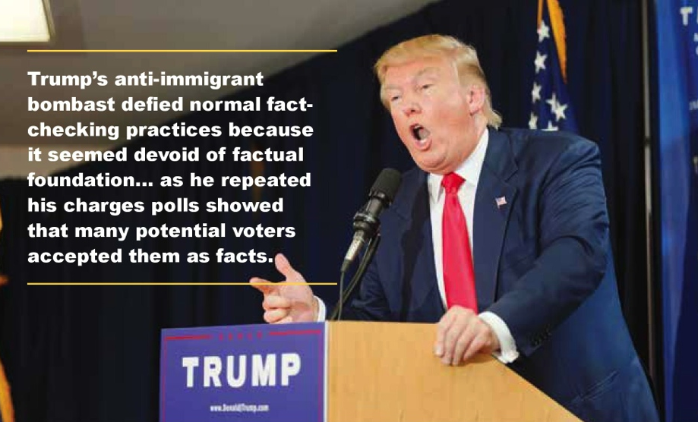

Slide 8
Media Weakness
Media in Europe fail to alert their countries to the imminent crisis.
Newsrooms lack capacity and informed specialists able to report a complex story
Media confusion over law and status of migrants, refugees, and asylum seekers
Tendency to stereotype and accept migration myths
Migrant voices missing from the story

Slide 9
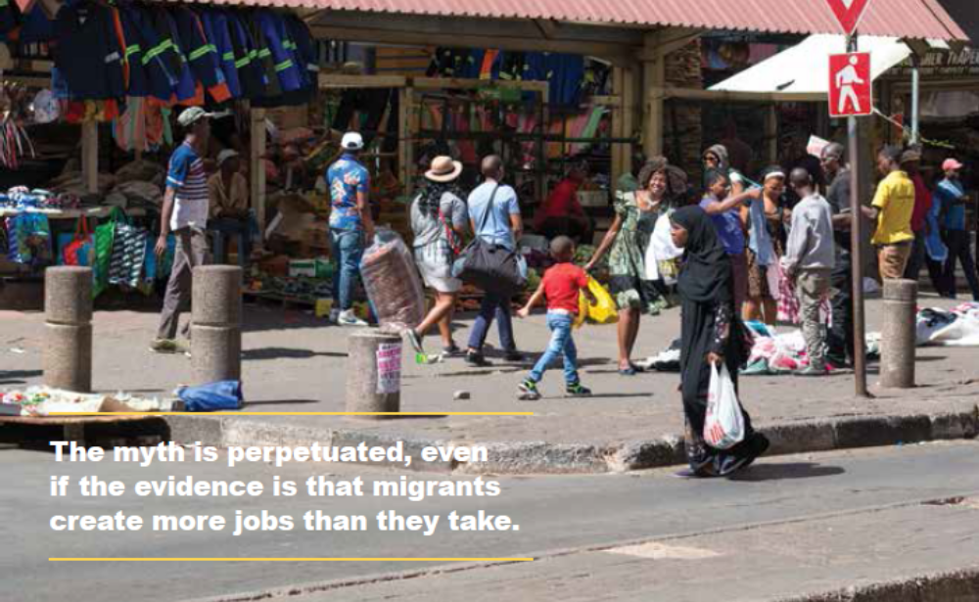

Slide 10
Ethical Challenges
Migrants and refugees are victims of hate-speech. Media fail to expose intolerance.
A rush to publish means fact-checking and verifying images is overlooked.
The rights of children and vulnerable minorities are forgotten.
Access to few migrant sources leads to unbalanced reporting and a lack of fairness.
There is not enough informed, factual and historical background to provide context

Slide 11
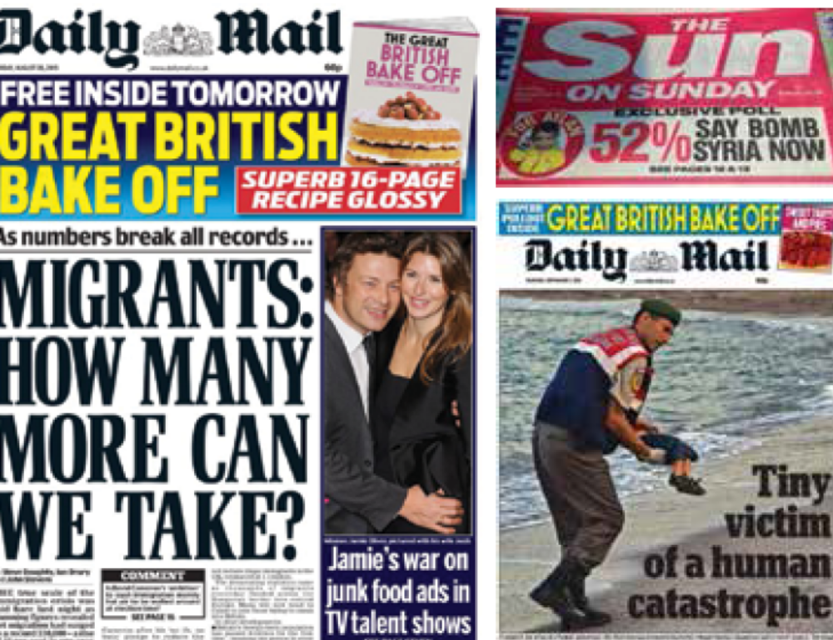

Slide 12
Numbers or Humanity?
Media tell the story either according to the numbers – using pejorative terms like “waves, swarms, or invasions” – often driven by careless or deliberate political language
Or they focus on human tragedy – as in the case of Aylan Kurdi
Both angles are legitimate, but a focus only on one is inevitably unbalanced

Slide 13
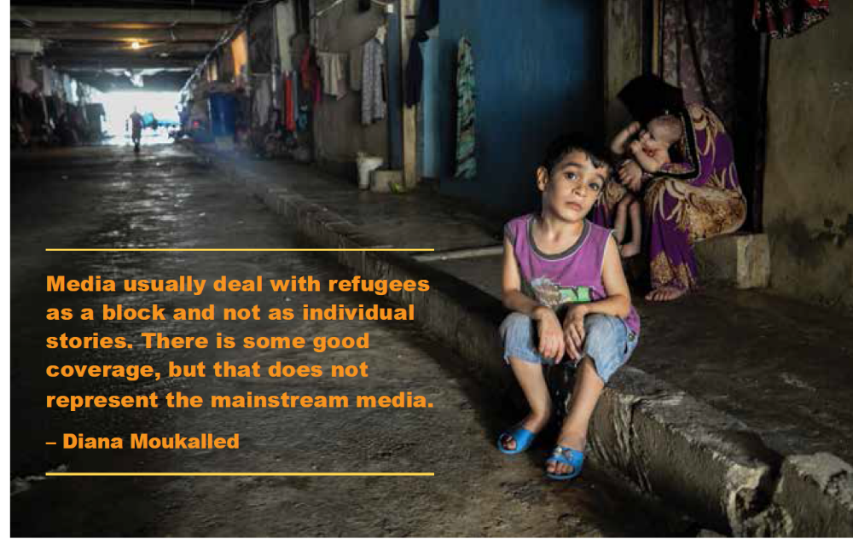

Slide 14
What Can We Do?
Hire specialist correspondents
Media training – on International law and rights
Establish links with migrant and refugee groups
Employ people from minorities in newsrooms
Use reliable sources and from migrant community
Challenge intolerance in political affairs
Promote responsible communications online

Slide 15
Focus on Hate - Speech
Develop Tools for Journalists, Educators and Others such as the 5-Point Test
Status of the Speaker
Reach of the Speech
Intention of the Speech
Content and Form
Economic, Social and Political Climate
Focus on Public Information – Media Literacy for Political, Religious, Community Leaders

Slide 16
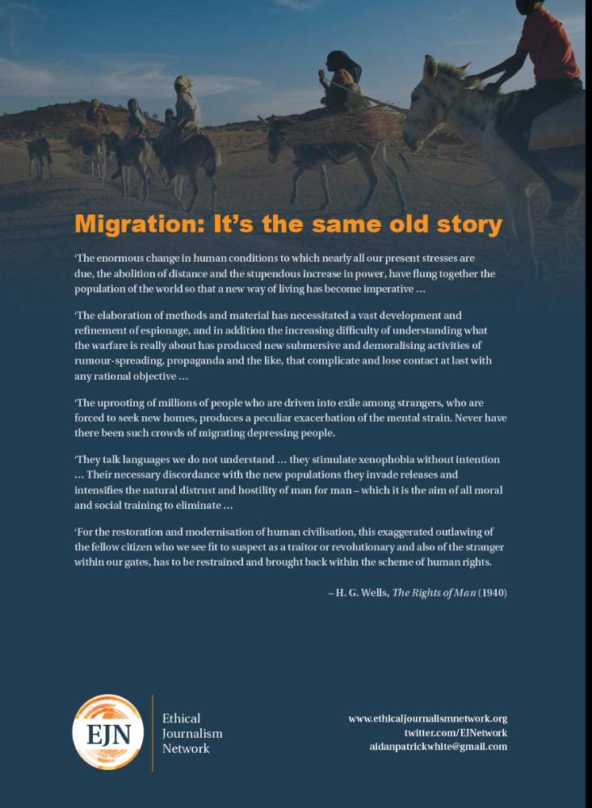
Migration is part of the human condition…
Our nations are built on migration …
Our economic and cultural future is rooted in the migration story.

Slide 17


