Slide 1

Sorry, But There‘s No Racism Here!
- A Diagnosis of Contemporary Forms of Racial Discrimination -
Arnold Bwele

Slide 2
Table of Contents
1. No Racism by Oliviero Toscani
2. The Race Issue
3. UN Human Rights Mechanisms
4. Lessons Learned by Civil Society

Slide 3

No Racism by Oliviero Toscani
Italian photographer, art director
Developed the intellectual fashion
Highlight the interest in multiculturalism
Make hymn to global understanding and racial harmony
1

Slide 4
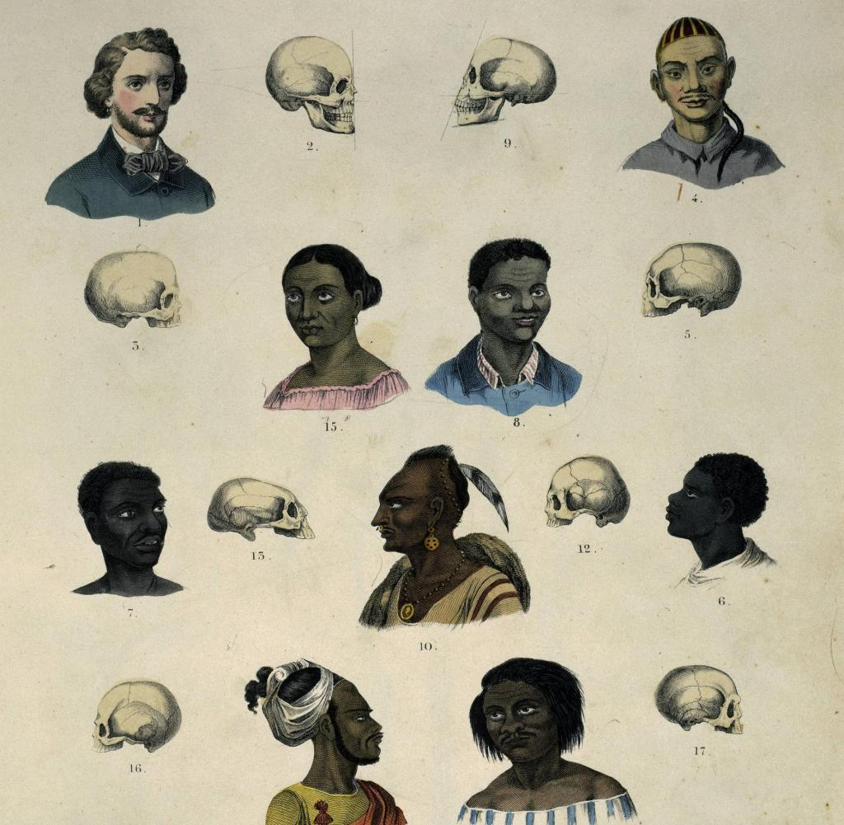
The Race Issue
There’s no scientific basis for race
Race is a social construct
It's been used to define and separate people for millennia
But the concept of race is not grounded in genetics
Exemples :
Race classification (Emmanuel Kant)
The Code Noir (King Louis XIV)
2

Slide 5

UN Human Rights Mechanisms
Measures are being taken to improve the human rights situation of people of African descent
International Decade for people of African descent (2015-2024)
But African descent continue to suffer inequality & discrimination
Racism remains a global concern
No country can claim to be free of racism but this is not really accepted
3

Slide 6
Lessons Learned by Civil Society
We all need to recognize and understand these attitude
We need a new diagnosis of contemporary forms of racism
We need to be open to identifying and controlling our own implicit biases
We need to be able to manage overt bigotry safely, learn from it, and educate others
These themes need to be a part of education, as well as institutional policy
We need to practice and model tolerance, respect, open-mindedness, and peace for each other
UN human rights mechanisms must be redefine and specify
4

Slide 7
Thank You

