Slide 1
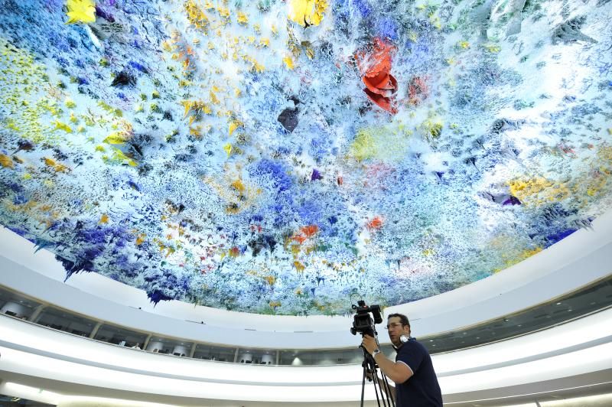
The Work of the HRC: Trends, Challenges and Main Outcomes/Future of the HRC –
Status Review

Slide 2
Key Milestones of the Human Rights Council
Main intergovernmental body within the United Nations responsible for strengthening the promotion and protection of human rights around the globe
Established in 2006 by the General Assembly (A/RES/60/251)
Composed of 47 Member States
The Review of the work and functioning of the HRC (2011)
  - Improved interaction with civil society and NGOs
  Streamlined working methods - improve transparency and enhance credibility of the Council (in practice, flexibility of the tool box: urgent debates, EID, special sessions, oral updates of the HC, investigative mechanisms.. etc)
  Strengthen the selection process of SRs – applications, interviews, commitments
The review of the status of the HRC (resolution GA65/Res/281 by 2026)

Slide 3
Meetings at the Council (regular sessions)
200 percent increase in the number of meetings since its inception in 2006

Slide 4
Interactive Dialogues at the Council
127 percent increase since 2010

Slide 5
Forecasted Interactive Dialogues

Slide 6
Enhanced Interactive Dialogues at the Council

Slide 7
Number of Panels at the Council

Slide 8
Resolutions adopted (Regular Sessions)

Slide 9
Challenges facing the Council
Perceived growing polarization in an increasingly complex geopolitical landscape – impedes collective action to prevent and respond to crises
Lengthening debates and increasingly diverse and specialized issues – Council met for record-breaking 14 weeks in 2023, and 15 weeks in 2024
Limits of human and financial resources particularly for OHCHR and LDCS-SIDS

Slide 10
Main Outcomes of the Council
New thematic initiatives adopted by the Council in 2024:
Culture of peace (A/HRC/RES/55/17)
Discrimination against intersex persons (A/HRC/RES/55/14)
Protection of seafarers (A/HRC/RES/56/18)
Safety of the child in the digital environment (A/HRC/RES/56/6)
Elimination of domestic violence (A/HRC/RES/57/18)
Social integration of persons released from detention (A/HRC/RES/57/9)
Recent Special Sessions
Sudan (2023)
Iran (2022)
Ukraine (2022)
Recent Intersessional Activities
Enhancing the participation of Indigenous Peoples (2024)
Human rights challenges in addressing the world drug problem (2024)
Human rights and 2030 Agenda (2024)
HC’s oral update on Ukraine (2023), Venezuela (2024)

Slide 11
Main Outcomes of the Council – some examples
Special Procedures: 46 thematic and 14 country mandates
11 International Commissions of Inquiry (COI) and Fact-Finding Missions (FFM)
In 2024, Indigenous Peoples participated for the first time in the Council during selected debates in their own right, instead of as NGOs
The Council has highlighted ways in which climate change affects human rights, including its impact on specific groups such as older persons, persons in vulnerable situations, persons with disabilities, migrants and displaced persons, and children
All 193 UN Member States have been reviewed under the UPR three times during the three cycles. Key to its success are the principles of equality and universality, in the spirit of constructive cooperation.

Slide 12
Future of the Council – Status Review
The General Assembly is expected to review the status of the Council by 2026 (Res 65/281)
The current President has undertaken a stocktaking of the Council’s achievements to assess its mandate, address its efficiency and effectiveness, and articulate its role in the wider UN ecosystem
The President appointed five co-facilitators to facilitate discussions and dialogue on the contribution of Geneva to the General Assembly process to review the status of the Human Rights Council

Slide 13
Future of the Council – Options
Cross-regional initiatives - countries across regional groups joining as co-penholders of resolutions or leading initiatives together. E.g. mechanism on the rights of peasants and others in rural areas led mainly by Bolivia and Luxembourg
Upcoming Intersessional activities - situation of human rights in the Bolivarian Republic of Venezuela; Ukraine; Nicaragua
Increase opportunities for delegations and key stakeholders to meet informally – builds trust-building and open and constructive dialogue
LDCS/SIDS increased engagement in the Council – e.g. Maldives, as member of the core group has brought the issue of human rights and climate change to the Council several years back, as pioneers, has also played key role in highlighting the human right to a clean, healthy and sustainable environment – led to creation of Special Rapporteur on the issue (55th session)
Council must remain a place of open dialogue and effective action

