Slide 1

Development is a Human Right

Slide 2


Contents:
What is the Right to Development?
Who are the rights holders and duty bearers of the Right to Development?
The Right to Development in Regional Human Rights Systems and Instruments
The Right to Development and the 2030 Agenda / SDGs

Slide 3
UN Declaration on the Right to Development (1986)
“an inalienable human right by virtue of which every human person and all peoples are entitled to participate in, contribute to, and enjoy economic, social, cultural and political development, in which all human rights and fundamental freedoms can be fully realized” (Article 1.1)
It is a human right, and the source of the human rights-based approach to development
It is both individual and collective
It has both national and international dimensions
It entitles everyone to participate in, contribute to and enjoy development in its economic, social, cultural and political dimensions
It should enable all human rights and fundamental freedoms

Slide 4
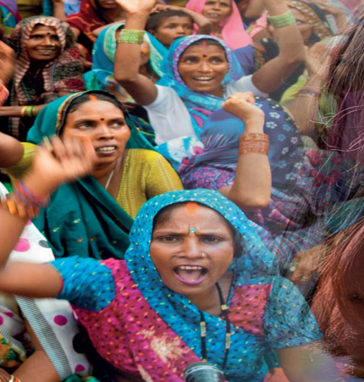

Principles and Elements
People-centred development: “The human person” is the central subject, participant and beneficiary of development
A human rights-based approach: Development should be carried out in a manner “in which all human rights and fundamental freedoms can be fully realized”
Participation: “Active, free and meaningful participation” of all individuals and peoples
Non-discrimination: “No distinction as to race, sex, language or religion”
Equity: “Fair distribution of the benefits” of development
Right of peoples to self-determination including full sover­eignty over all their natural wealth and resources

Slide 5
Principles and Elements (cont’d)
Like all human rights, the principles of equality, non-discrimination, participation, accountability and transparency are intrinsic to the RTD
States should promote international peace and security and disarmament and use released resources for development
Equality of opportunity for development is a prerogative for both nations and individuals who make up nations
Development is a comprehensive economic, social, cultural and political process, which aims at the constant improvement of human well-being
States have a duty to cooperate to create an enabling local and global environment for development and to eliminate obstacles to development
The human person is the central subject, active participant and beneficiary of the RTD
The RTD requires appropriate national and international development policies and an enabling social and international order to realize all rights and freedoms
States must act to eliminate human rights violations of all forms

Slide 6
Who are the rights holders and duty bearers of the right to development?
Rights Holders: The human being, both individually and collectively
  All individuals
  All peoples and the entire population
Duty bearers:
States have the primary responsibility to respect, protect and fulfil the RTD at three levels (A/HRC/15/WG.2/TF/2/Add.2, )
  i) Internally through national policies and programmes
  ii) Internationally, through policies extending beyond their jurisdictions
  iii) Collectively, through global and regional partnerships
International Community
All human beings, and all those whose actions and/or omissions have an impact on human rights and on the environment in which these rights are fulfilled

Slide 7

The RTD in Global and Regional
Human Rights Instruments and Systems
United Nations Declaration on the Right to Development
Inter-American Human Rights System
African Human Rights System
Arab Charter on Human Rights
Association of Southeast Asian Nations (ASEAN) Human Rights Declaration
OIC Independent Permanent Human Rights Commission – Abu Dhabi Declaration
ASEAN Declaration on Promoting the Right to Development and Right to Peace Towards Realising Inclusive and Sustainable Development

Slide 8
Mandates and Mechanisms on the RTD
Mandate of the UN Secretary General: to submit an annual report to the General Assembly and an interim report to the Human Rights Council on the implementation of the annual RTD resolution, including on efforts undertaken at the national, regional and international levels in the promotion and realization of the right to development
The UN High Commissioner for Human Rights: mandate to “promote and protect the realization of the right to development and to enhance support from relevant bodies of the United Nations system for this purpose”, and to mainstream the RTD at all levels
Biennial Panel on the Right to Development
Intergovernmental Working Group on the Right to Development
Special Rapporteur on the Right to Development
Expert Mechanism on the Right to Development

Slide 9
The Draft Covenant on the Right to Development
In 2023, the Human Rights Council adopted resolution A/HRC/RES/54/18
whereby it transmitted the Draft International Covenant on the Right to Development A/HRC/54/50 to the General Assembly. (And A/HRC/54/50/Add.1 with the commentaries)
The General Assembly noted in its resolution A/RES/78/203 that the Draft Covenant has been submitted to the General Assembly for its consideration, negotiation and subsequent adoption.

Slide 10
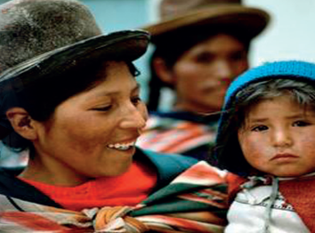
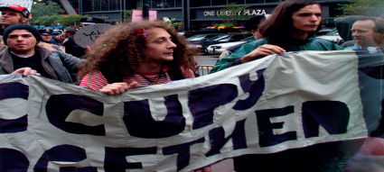

Inter-American Human Rights System
Charter of the Organization of American States 1948
Details the concept, rights and duties of integral development, the overall purpose of which should be the “establishment of a more just economic and social order that will make possible and contribute to the fulfilment of the individual” (art. 33)
Integral development is the common and joint responsibility of Member States (art. 31), preferably through multilateral organizations (art. 32)
Cooperation among States in this regard “should include the economic, social, educational, cultural, scientific and technological fields, support the achievement of national objectives of the Member States, and respect the priorities established by each country in its development plans, without political ties or conditions (art. 32)

Slide 11

Inter-American Human Rights System (cont’d)
American Convention on Human Rights 1969
Article 26. Progressive Development
The States Parties undertake to adopt measures, both internally and through international cooperation, especially those of an economic and technical nature, with a view to achieving progressively, by legislation or other appropriate means, the full realization of the rights implicit in the economic, social, educational, scientific, and cultural standards set forth in the Charter of the Organization of American States as amended by the Protocol of Buenos Aires

Slide 12

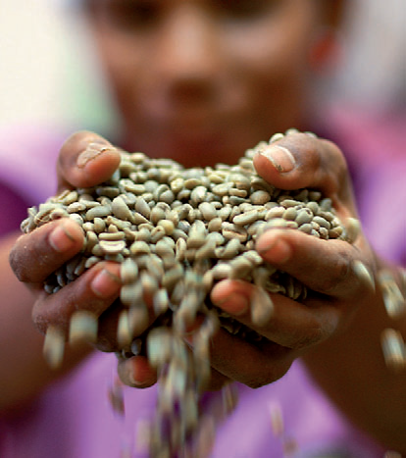
African Human and Peoples’ Rights System
African Charter on Human and Peoples ’ Rights 1981
Article 22
1. All peoples shall have the right to their economic, social and cultural development with due regard to their freedom and identity and in the equal enjoyment of the common heritage of mankind
2. States shall have the duty, individually or collectively, to ensure the exercise of the right to development

Slide 13

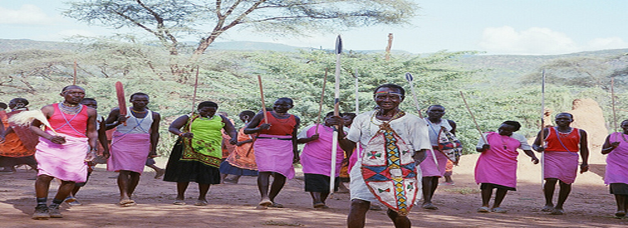
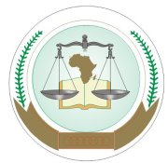
African Human and Peoples’ Rights System (cont’d)
55/96 : Social and Economic Rights Action Center (SERAC) and Center for Economic and Social Rights (CESR) / Nigeria (2001)
227/99 Democratic Republic of Congo / Burundi, Rwanda, Uganda (2003)
266/03 Kevin Mgwanga Gunme et al / Cameroon (2009)
279/03-296/05 : Sudan Human Rights Organisation & Centre on Housing Rights and Evictions (COHRE) / Sudan (2009)
276/03 Centre for Minority Rights Development (Kenya) and Minority Rights Group (on behalf of Endorois Welfare Council) / Kenya (2009)
Resolution on the preparation of a General Comment on the right to development in Africa - ACHPR.Res.586 (LXXIX) 2024
006/2012 – African Commission on Human and Peoples’ Rights v. Republic of Kenya (2017)
African Commission on Human and Peoples ’ Rights
African Court on Human and Peoples ’ Rights

Slide 14
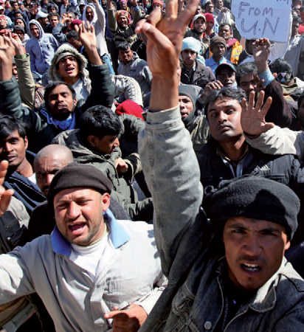
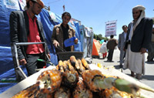

Arab Charter on Human Rights 2004
Article 37
The right to development is a fundamental human right. All State Parties shall establish development policies and take measures to ensure this right. They must give effect to the values of solidarity and cooperation among them and, at the international level, to eliminate poverty and achieve economic, social, cultural and political development. In accordance with this right, every citizen shall have the right to participate in the development, and contribute to and enjoy the benefits, of their goods and fruits of their labour.
Other relevant Articles include:
Article 39
Young persons have the right to be afforded the most ample opportunities for physical and mental development

Slide 15


Association of Southeast Asian Nations (ASEAN) Human Rights Declaration 2012
A section of the ASEAN Human Rights Declaration (2012) is devoted to the right to development. In paragraph 37, Member States recognize that the implementation of the right to development requires effective development policies at the national level as well as international cooperation, and that States should mainstream aspects of the right to development into ASEAN community building as well as work with the international community to promote development
See also:
Paragraph 35 (definition based on the UN Declaration on the RTD)
Paragraph 36 (On the duty to adopt development programmes including sustainable development and progressive narrowing of the development gap in ASEAN

Slide 16

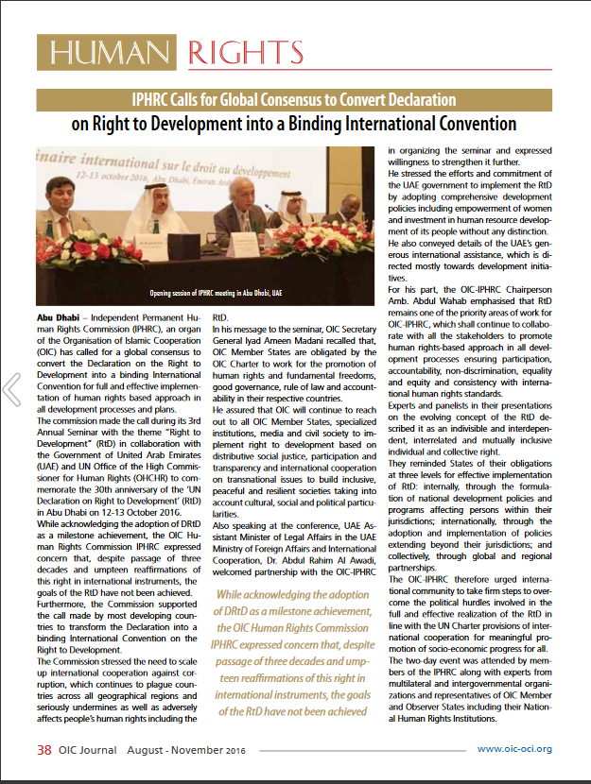
Abu Dhabi Declaration 2016
Independent Permanent Human Rights Commission of the Organization of Islamic Cooperation (OIC) adopted Abu Dhabi Declaration in 2016.
The Declaration urged the OIC Member States to take concrete and urgent actions to:
reinvigorate political will for implementing the RTD;
mainstream human rights and the RTD norms into development plans and ensure system-wide coherence to bridge implementation gaps;
strengthen international cooperation with multilateral development institutions to address persistent challenges and create linkages with the ongoing international initiatives like the SDGs taking into account national circumstances and priorities

Slide 17
ASEAN Declaration on Promoting the Right to Development and Right to Peace Towards Realising Inclusive and Sustainable Development
Article 1: To advance the right to development, the right to enjoy peace, and inclusive and sustainable development in the region through an ASEAN-led, ASEAN-owned, and whole-of-ASEAN approach, in accordance with the ASEAN Human Rights Declaration and the Phnom Penh Statement on the Adoption of the ASEAN Human Rights Declaration.
Article 4: To strengthen national and regional policies and legislative frameworks that promote the right to development, the right to enjoy peace, and inclusive and
sustainable development for all peoples of ASEAN in furtherance of their active,
free and meaningful participation and contribution in the development process and the equitable distribution of its resulting benefits for all.
Article 10: To task the ASEAN Intergovernmental Commission on Human Rights (AICHR) and relevant ASEAN organs and bodies to follow-up on the realisation of this Declaration in line with ASEAN 2045: Our Shared Future with assured continuous support and adequate resources for this purpose.

Slide 18
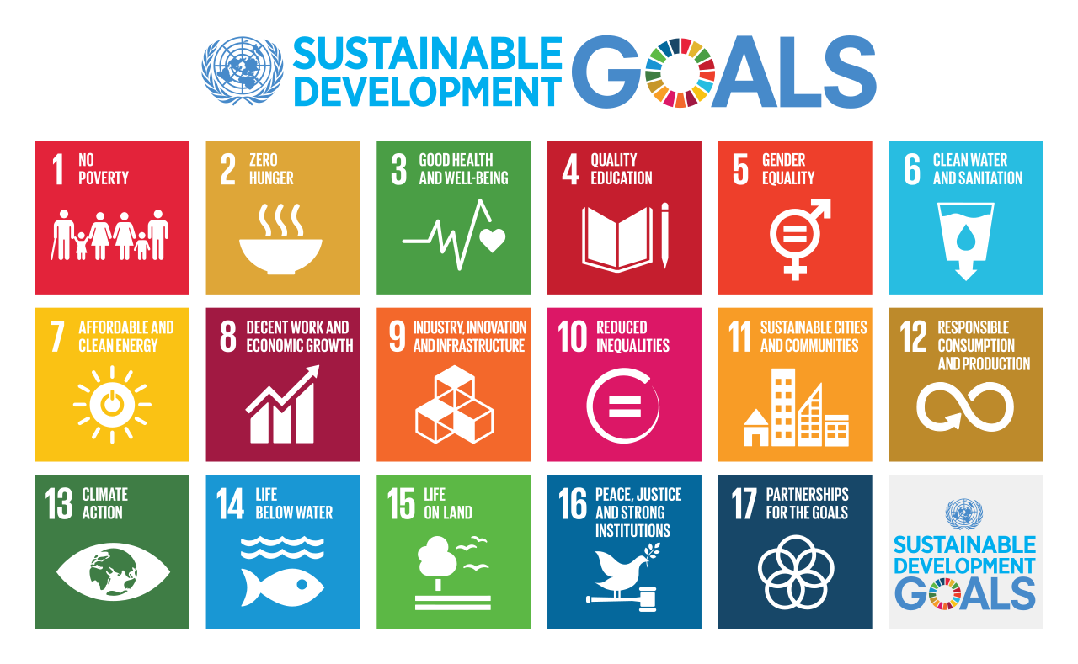
RTD and the 2030 Agenda

Slide 19
RTD and the 2030 Agenda and SDGs, the Sevilla Commitment and the Paris Agreement
International cooperation, solidarity and friendly relations are essential to realizing the RTD, and for the comprehensive development of developing countries (RTD Declaration - Preamble, Arts. 1.2, 3, 4, 6 and others).
The RTD requires good governance, equality of opportunity for all in their access to basic resources and services, fair distribution of income, an active role for women in the development process and economic and social reforms to eradicate social injustice (RTD Declaration Art.8).
The 2030 Agenda is informed by the RTD Declaration (para. 10) and recognizes respect for human rights, including the right to development, as a prerequisite for peace and security and for sustainable development (para. 35).
Trade, investment, finance, aid, debt, technology, intellectual property and other such global arrangements must be addressed through the RTD's normative framework, to create an enabling international environment for development.

Slide 20
The relationship between the RTD and SDGs:
Mutual reinforcement and synergy in action
Great Strides Forward v. Uneven Progress: For people in Africa, least developed countries, landlocked developing countries, small island developing States, and most other developing countries, as well as for poor, vulnerable, marginalized and disadvantaged communities in all countries.
The 2030 Agenda aims “to leave no one behind” and commits to “reaching the furthest behind first” by ensuring that the SDGs and targets are met “for all nationals and peoples and for all segments of society.”
SDG 10 specifically underlined the target of “reducing inequality within and among countries”, echoing the aspiration of the right to development in addressing the development gaps among countries.
“The 17 Sustainable Development Goals and 169 targets … seek to realize the human rights of all and to achieve gender equality and the empowerment of all women and girls.” (A/RES/70/1, preamble)
The 2030 Agenda… “is grounded in the Universal Declaration of Human Rights, international human rights treaties… It is informed by other instruments such as the Declaration on the Right to Development.” (A/RES/70/1, para. 10)
“The Agenda recognizes the need to build peaceful, just and inclusive societies that provide equal access to justice and that are based on respect for human rights, including the right to development …” (A/RES/70/1, para. 35)

Slide 21
RTD and SDGs
Mutual reinforcement and synergy in action
RTD Principles and Elements
The 2030 Agenda
SDGs and targets
People-centered development
Preamble: “realize human rights for all”, “People” (A/RES/70/1)
SDGs 1-16
A Human Rights-based Approach
State as primary duty bearer
Paras. 1, 18, 19, 21, 28, 30, 32, 58, 84, 90 (A/RES/70/1)
Participation, equality, non-discrimination, accountability and transparency
Preamble, Paras. 3, 8, 13, 14, 20, 23, 25, 27, 35, 44 (A/RES/70/1)
SDGs 1, 2, 4, 5, 8, 10, 16

Slide 22
RTD and SDGs
Mutual reinforcement and synergy in action (cont’d)
RTD Principles and Elements
The 2030 Agenda
SDGs and targets
Promote international peace and security
Preamble “Peace”, Paras. 3, 17, 35, 37, 42, 49, 64
SDG 16
Good governance & global partnership: national and international dimensions of development
SDGs 10, 16, 17,
a, b, c targets under all SDGs
Means of implementation: national and international dimensions of development;
global partnership
Preamble “Partnership”, Paras. 39, 40, 60-71, 78-91

Slide 23
The RTD and SDGs
The SDGs provide renewed opportunities and contribute to operationalizing the RTD:
Consistent goals and targets
Similar emphasis on Duties of States
Universal adoption of SDGs: strong political will
Enabling environment, policy space and policy coherence
The international dimensions of the RtD: SDG 17 on strengthening the means of implementation, revitalizing the global partnership and AAAA

Slide 24
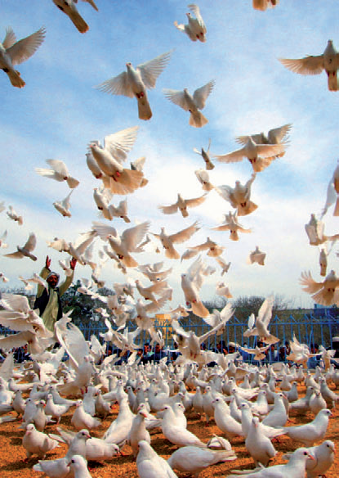
RTD and SDGs for
Everyone, Everywhere!
The Declaration on the Right to Development provides a viable path to the Prevention of Conflict, Peacebuilding, Sustained Peace and Sustainable Development
The 2030 Agenda and SDGs reflect and integrate human rights principles and requirements, and provide a plan of action for people, planet and prosperity.

Slide 25
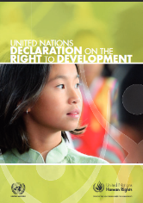
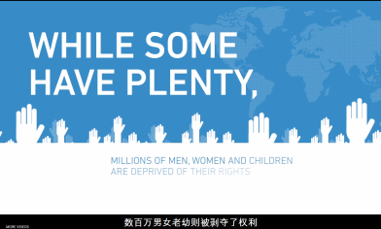
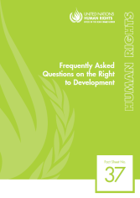
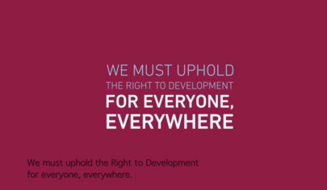
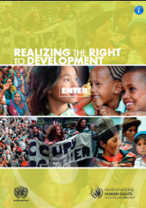
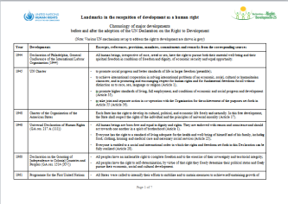
Resource Materials on the RTD
Online videos:
Development is a Human Right
The Right to Development for everyone everywhere
A booklet containing the UN Declaration on the Right to Development
Frequently Asked Questions, OHCHR Fact sheet No. 37
A book – ‘Realizing the Right to Development’
Landmarks in the
recognition of
development as a
human right
All materials are available at:
http://www.ohchr.org/EN/Issues/Development/Pages/InformationMaterials.aspx
http://www.ohchr.org/EN/Issues/Development/Pages/DevelopmentIndex.aspx

Slide 26
Thank you!
Contact
ohchr-r2d@un.org

