Slide 1
OHCHR
The Right to Development and
The Sustainable Development Goals
Mutual Reinforcement and Synergy in Action

Slide 2
    CONTENTS
RTD & SDG: Mutual reinforcement and synergy in action
What is the Right to Development (RTD)?
Who are the rights holders and duty bearers of the right to development?
The UN Human Rights Office, the Working Group, the Special Rapporteur and the Expert Mechanism on the RTD
The main challenges to the realization of the Right to Development
The Right to Development, 2030 Agenda and SDGs, international governance, cooperation and partnership

Slide 3
UN Declaration on the Right to Development (1986)
It is a human right, and the source of the human rights-based approach to development
“an inalienable human right by virtue of which every human person and all peoples are entitled to participate in, contribute to, and enjoy economic, social, cultural and political development, in which all human rights and fundamental freedoms can be fully realized”
(Article 1.1)
It is both individual and collective
It has both national and international dimensions
It entitles everyone to participate in, contribute to and enjoy development in its economic, social, cultural and political dimensions

Slide 4
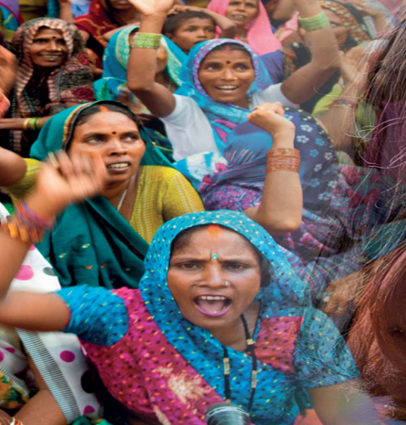

RTD Principles and Elements
People-centred development. “The human person” is the central subject, participant and beneficiary of development
A human rights-based approach. Development should be carried out in a manner “in which all human rights and fundamental freedoms can be fully realized”
Participation. “Active, free and meaningful participation” of all individuals and peoples
Non-discrimination. “No distinction as to race, sex, language or religion”
Equity. “Fair distribution of the benefits” of development
Right of peoples to self-determination including full sover­eignty over all their natural wealth and resources

Slide 5
RTD Principles and Elements
Like all human rights, the principles of equality, non-discrimination, participation, accountability and transparency are intrinsic to the RTD
States should promote international peace and security and disarmament and use released resources for development
Equality of opportunity for development is a prerogative for both nations and individuals who make up nations
Development is a comprehensive economic, social, cultural and political process, which aims at the constant improvement of human well-being
States have a duty to cooperate to create an enabling local and global environment for development and to eliminate obstacles to development
The human person is the central subject, active participant and beneficiary of the RTD
The RTD requires appropriate national and international development policies and an enabling social and international order to realize all rights and freedoms
States must act to eliminate human rights violations of all forms

Slide 6
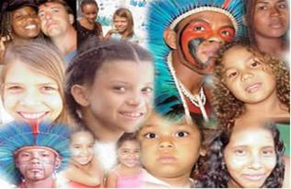
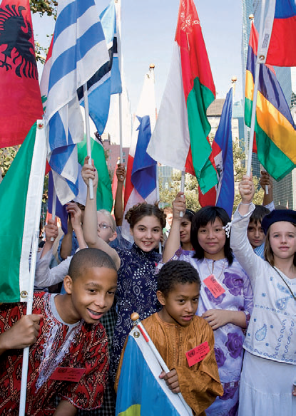
Who are the rights holders and duty bearers of the right to development?
RIGHTS HOLDERS:
The human being, both individually and collectively
a) All individuals
b) All peoples and the entire population
DUTY BEARERS:
States have the primary responsibility to respect, protect and fulfil the RTD at three levels (A/HRC/15/WG.2/TF/2/Add.2)
Internally through national policies and programmes
Internationally, through policies extending beyond their jurisdictions
Collectively, through global and regional partnerships
International Community
All human beings, and all those whose actions and/or omissions have an impact on human rights and on the environment in which these rights are fulfilled

Slide 7

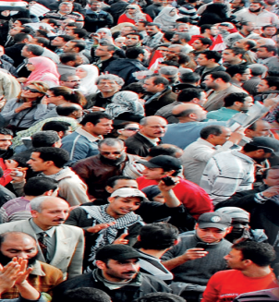
The RTD in Global and Regional
Human Rights Instruments and Mechanisms
United Nations Declaration on the Right to Development
Inter-American Human Rights System
African Human Rights System
Arab Charter on Human Rights
Association of Southeast Asian Nations (ASEAN)
Human Rights Declaration
OIC Independent Permanent Human Rights Commission – Abu Dhabi Declaration
ASEAN Declaration on Promoting the Right to Development and Right to Peace Towards Realising Inclusive and Sustainable Development

Slide 8
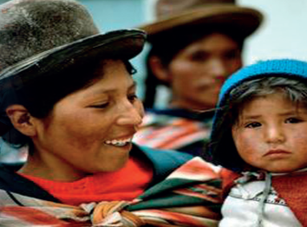
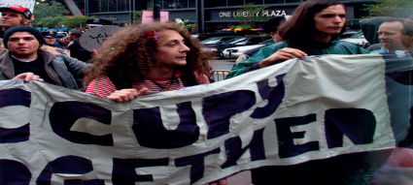

Inter-American Human Rights System
Charter of the Organization of American States 1948
Details the concept, rights and duties of integral development, the overall purpose of which should be the “establishment of a more just economic and social order that will make possible and contribute to the fulfilment of the individual” (art. 33)
Integral development is the common and joint responsibility of Member States (art. 31), preferably through multilateral organizations (art. 32)
Cooperation among States in this regard “should include the economic, social, educational, cultural, scientific and technological fields, support the achievement of national objectives of the Member States, and respect the priorities established by each country in its development plans, without political ties or conditions (art. 32)

Slide 9

Inter-American Human Rights System
American Convention on Human Rights 1969
Article 26. Progressive Development
The States Parties undertake to adopt measures, both internally and through international cooperation, especially those of an economic and technical nature, with a view to achieving progressively, by legislation or other appropriate means, the full realization of the rights implicit in the economic, social, educational, scientific, and cultural standards set forth in the Charter of the Organization of American States as amended by the Protocol of Buenos Aires

Slide 10
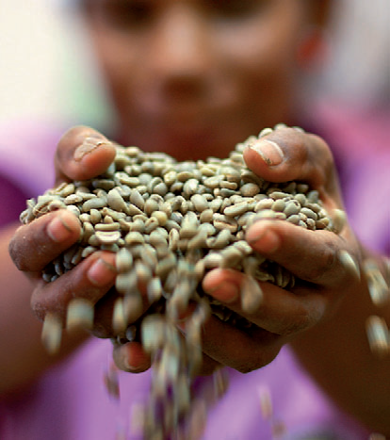

African Human Rights System
African Charter on Human and Peoples ’ Rights 1981
Article 22
1. All peoples shall have the right to their economic, social and cultural development with due regard to their freedom and identity and in the equal enjoyment of the common heritage of mankind
2. States shall have the duty, individually or collectively, to ensure the exercise of the right to development

Slide 11

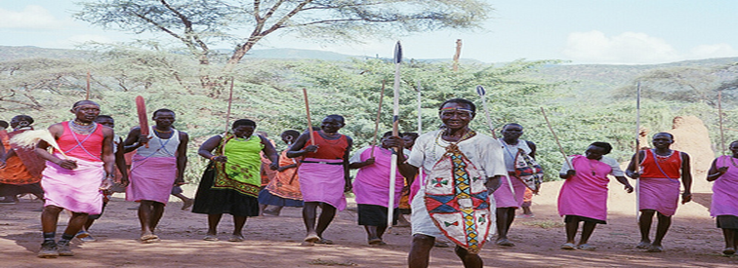

African System on Human and Peoples’ Rights
African Human Rights System
CASE LAW
55/96 : Social and Economic Rights Action Center (SERAC) and
Center for Economic and Social Rights (CESR) / Nigeria (2001)
227/99 Democratic Republic of Congo / Burundi,
Rwanda, Uganda (2003)
266/03 Kevin Mgwanga Gunme et al / Cameroon (2009)
279/03-296/05 : Sudan Human Rights Organisation & Centre on
Housing Rights and Evictions (COHRE) / Sudan (2009)
276/03 Centre for Minority Rights Development (Kenya) and Minority Rights Group (on behalf of Endorois Welfare Council) /
Kenya (2009)
Resolution on the preparation of a General Comment on the right to development in Africa - ACHPR.Res.586 (LXXIX) 2024
006/2012 – African Commission on Human and Peoples’ Rights v. Republic of Kenya (2017)
African Commission on Human and Peoples ’ Rights
African Court on Human and Peoples ’ Rights

Slide 12
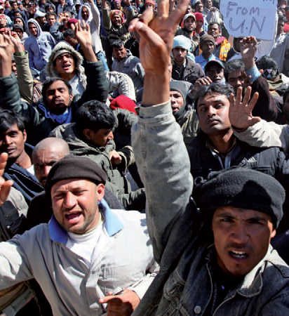
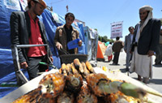

Arab Charter on Human Rights 2004
Article 37
The right to development is a fundamental human right. All State Parties shall establish development policies and take measures to ensure this right. They must give effect to the values of solidarity and cooperation among them and, at the international level, to eliminate poverty and achieve economic, social, cultural and political development. In accordance with this right, every citizen shall have the right to participate in the development, and contribute to and enjoy the benefits, of their goods and fruits of their labour.
Other relevant Articles include:
Article 39
Young persons have the right to be afforded the most ample opportunities for physical and mental development

Slide 13


Association of Southeast Asian Nations (ASEAN) Human Rights Declaration 2012
A section of the ASEAN Human Rights Declaration (2012) is devoted to the right to development. In paragraph 37, Member States recognize that the implementation of the right to development requires effective development policies at the national level as well as international cooperation, and that States should mainstream aspects of the right to development into ASEAN community building as well as work with the international community to promote development
See also:
Paragraph 35: definition based on the UN Declaration on the RTD
Paragraph 36: on the duty to adopt development programmes including sustainable development and progressive narrowing of the development gap in ASEAN

Slide 14

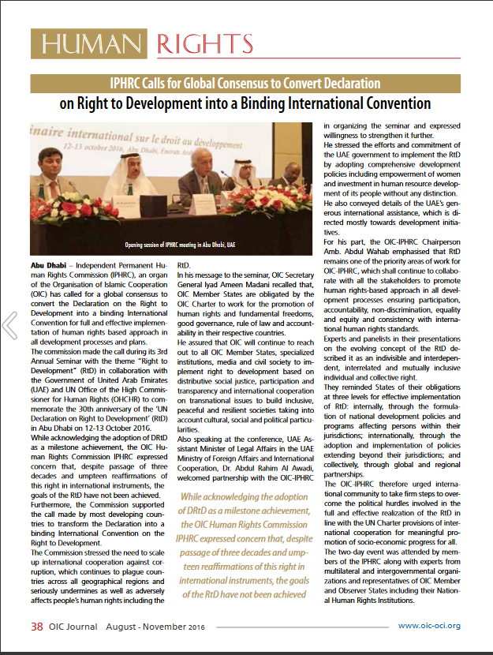
Abu Dhabi Declaration 2016
Organization of Islamic Cooperation (OIC)
Independent Permanent Human Rights Commission
Affirmed that the RTD is an indivisible, interdependent, interrelated and mutually inclusive individual and collective right, which belongs to all individuals and peoples in all countries without discrimination on any grounds, including foreign and colonial occupation
Urged the OIC Member States to take concrete and urgent actions to:
reinvigorate political will for implementing the RTD;
mainstream human rights and the RTD norms into development plans and ensure system-wide coherence to bridge implementation gaps;
strengthen international cooperation with multilateral development institutions to address persistent challenges and create linkages with the ongoing international initiatives like the SDGs taking into account national circumstances and priorities

Slide 15
ASEAN Declaration on Promoting the Right to Development and Right to Peace Towards Realising Inclusive and Sustainable Development
Article 1: To advance the right to development, the right to enjoy peace, and inclusive and sustainable development in the region through an ASEAN-led, ASEAN-owned, and whole-of-ASEAN approach, in accordance with the ASEAN Human Rights Declaration and the Phnom Penh Statement on the Adoption of the ASEAN Human Rights Declaration.
Article 4: To strengthen national and regional policies and legislative frameworks that promote the right to development, the right to enjoy peace, and inclusive and
sustainable development for all peoples of ASEAN in furtherance of their active,
free and meaningful participation and contribution in the development process and the equitable distribution of its resulting benefits for all.
Article 10: To task the ASEAN Intergovernmental Commission on Human Rights (AICHR) and relevant ASEAN organs and bodies to follow-up on the realisation of this Declaration in line with ASEAN 2045: Our Shared Future with assured continuous support and adequate resources for this purpose.

Slide 16
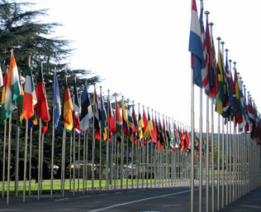
The RTD and the UN Human Rights Office
The RTD is specifically mentioned in UNGA Res. 48/141 which established the Office of the UN High Commissioner for Human Rights. The High Commissioner is mandated to “promote and protect the realization of the right to development and to enhance support from relevant bodies of the United Nations system for this purpose”.
Supports the Working Group, the Special Rapporteur and the Expert Mechanism on the RTD;
Prepares the annual report submitted by SG and HC to GA and HRC on the RTD as well as on strengthening and enhancing international cooperation in the field of human rights;
Supports Human Rights Mechanisms e.g. Special Procedures and Treaty bodies which address related issues such as International Solidarity, Democratic Order, Unilateral Coercive Measures, Poverty, Foreign Debt, and Economic, Social and Cultural Rights;
Organizes events, raises awareness, produces resources and builds capacity on RTD and related topics including trade, investment, financing for development, Least Developed Countries, Landlocked Developing Countries and Small Island Developing States;
Research, analysis and advocacy on the RTD, international cooperation, trade, investment, finance, technology, intellectual property, and Human Rights Impact Assessments;
Supports RTD implementation at the global, regional and national levels.
Notes:
GA Mandate

Slide 17
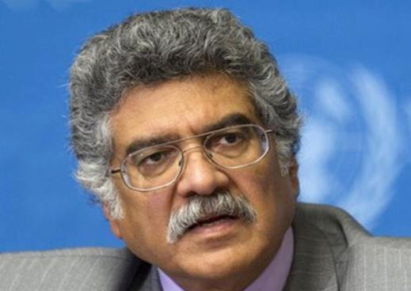
The Intergovernmental
Working Group on the RTD
The Working Group was established in 1998 with the following mandate:
to monitor and review progress made in the promotion and implementation of the RTD as elaborated in the Declaration at the national and international levels, providing recommendations thereon and further analyzing obstacles to its full enjoyment, focusing each year on specific commitments in the Declaration;
to review information submitted by States and other stakeholders on their activities related to RTD; and
Mr. Zamir Akram
Chairperson of the
Inter-Governmental
Working Group on the Right to Development
to present to the Human Rights Council an annual report on its deliberations and suggesting possible programmes of technical assistance at the request of interested countries with the aim of promoting the implementation of the right to development

Slide 18

The Special Rapporteur on the RTD
The Mandate was established by the Human Rights Council on 28 September 2016. It includes:
Contributing to the promotion, protection and fulfilment of the RTD in the context of the 2030 Agenda and SDGs, Addis Ababa Action Agenda, Paris Agreement and Sendai Framework for Disaster Risk Reduction 2015-2030
Engaging and supporting efforts to mainstream RTD among various stakeholders aimed at strengthening the revitalized global partnership for sustainable development from the perspective of the RTD;
Mr. Surya Deva
Special Rapporteur
on the Right to
Development
Contributing to the work of the Working Group on RTD;
Submitting studies requested by the HRC;
Submitting an annual report to the HRC and to the GA

Slide 19
Expert Mechanism on the RTD
The Mandate was established by the Human Rights Council on 27 September 2019. It includes:
Holds two annual sessions for three days each, and submits an annual report to the Human Rights Council on its work and engages in an interactive dialogue with the Council;
Undertakes thematic studies and study visits;
Holds interactive discussions and consultations;
Participates in outreach and communications initiatives;
Reports to the General Assembly and the Human Rights Council

Slide 20
Main challenges for the realization of the RTD
Conceptual:
Political:
Disagreement on the nature of the duties of States and on relative emphasis to be placed on national and international responsibilities
Lack of political will
Lack of consensus among Member States
Practical:
Disagreement among Member States on the way forward on the RTD
Failures in governance, absence of an enabling environment for development and a social and international order with conducive public, economic and development policies; inequalities, discrimination, unfair distribution and lack of participation; corruption, tax evasion, tax havens and illicit financial flows; unfair trade, investment, finance, intellectual property and other arrangements etc.
Politicization and polarization in intergovernmental debates
Lack of understanding and constituency in support of the RTD
Lack of policy coherence and RTD integration across the UN system

Slide 21
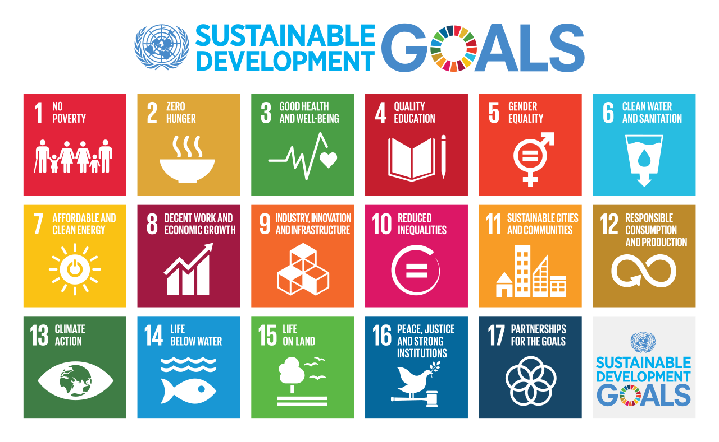
RTD and the 2030 Agenda for SDGs

Slide 22
The RTD and the 2030 Agenda for
Sustainable Development
Mutual reinforcement and synergy in action
Great Strides Forward v. Uneven Progress: For people in Africa, least developed countries, landlocked developing countries, small island developing States, and most other developing countries, as well as for poor, vulnerable, marginalized and disadvantaged communities in all countries.
The 2030 Agenda aims “to leave no one behind” and commits to “reaching the furthest behind first” by ensuring that the SDGs and targets are met “for all nationals and peoples and for all segments of society.”
SDG 10 specifically underlined the target of “reducing inequality within and among countries”, echoing the aspiration of the right to development in addressing the development gaps among countries.
“The 17 Sustainable Development Goals and 169 targets … seek to realize the human rights of all and to achieve gender equality and the empowerment of all women and girls.” (A/RES/70/1, preamble)
The 2030 Agenda… “is grounded in the Universal Declaration of Human Rights, international human rights treaties… It is informed by other instruments such as the Declaration on the Right to Development.” (A/RES/70/1, para. 10)
“The Agenda recognizes the need to build peaceful, just and inclusive societies that provide equal access to justice and that are based on respect for human rights, including the right to development …” (A/RES/70/1, para. 35)

Slide 23
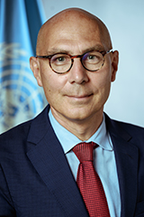
The RTD and the 2030 Agenda for
Sustainable Development
“I firmly believe that progress in realising the full spectrum of human rights can reverse today’s destructive trends. And that the best way to ensure global security is through sustainable development and the realization of human rights – not trade wars or arms races.
The right to development is unique and essential to this shift, because it explicitly recognizes the interconnectedness of individuals, communities, and countries.”
Volker Türk, UN High Commissioner for Human Rights

Slide 24
The RTD and the 2030 Agenda for
Sustainable Development
RTD and SDGs: Mutual reinforcement and synergy in action
RTD Principles and Elements
The 2030 Agenda
SDGs and targets
People-centered development
Preamble: “realize human rights for all”, “People” (A/RES/70/1)
SDGs 1-16
A Human Rights-based Approach
State as primary duty bearer
Paras. 1, 18, 19, 21, 28, 30, 32, 58, 84, 90 (A/RES/70/1)
Participation, equality, non-discrimination, accountability and transparency
SDGs 1, 2, 4, 5, 8, 10, 16
Preamble, Paras. 3, 8, 13, 14, 20, 23, 25, 27, 35, 44 (A/RES/70/1)

Slide 25
The RTD and the 2030 Agenda for
Sustainable Development
RTD and SDGs: Mutual reinforcement and synergy in action
RTD Principles and Elements
The 2030 Agenda
SDGs and targets
Promote international peace and security
Preamble “Peace”, Paras. 3, 17, 35, 37, 42, 49, 64
SDG 16
Good governance & global partnership: national and international dimensions of development
SDGs 10, 16, 17,
a, b, c targets under all SDGs
Means of implementation: national and international dimensions of development;
global partnership
Preamble “Partnership”, Paras. 39, 40, 60-71, 78-91

Slide 26
The RTD and the
Development Policy Framework
Sevilla Commitment on Financing for Development
The Paris Agreement on Climate Change
The Sendai Framework for Disaster Risk Reduction 2015-2030
Trade, investment, finance, aid, debt, technology, intellectual property and other such global arrangements must be addressed through the RTD's normative framework, to create an enabling international environment for development

Slide 27
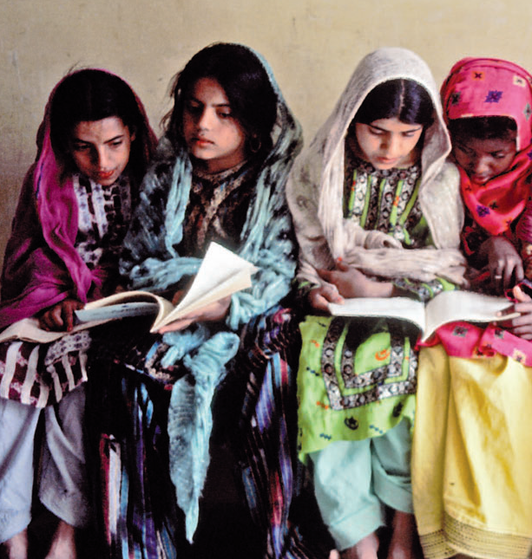
The RTD is a Key to
Sustainable Development
‘The right to development should be fulfilled so as to meet equitably the developmental and environmental needs of present and future generations’
Principle 3, 1992 Rio Declaration on Environment and Development;
Article 11, 1993 Vienna Declaration and Programme of Action.

Slide 28
The RTD is a Key to
Sustainable Development
The Added value of RTD to SDGs:
Human rights of individuals and peoples as an end: respect, protect and fulfil all human rights for all
The human rights-based approach: entitlements and stronger claims, emphasis on accountability
States as primary duty-bearers
States’ duty to cooperate: international cooperation and partnership are obligations

Slide 29
SDGs as Renewed Opportunities to Operationalize the RTD
Contribution of SDGs to Operationalizing the RTD:
Consistent goals and targets
Similar emphasis on Duties of States
Universal adoption of SDGs: strong political will
Enabling environment, policy space and policy coherence
The international dimensions of the RTD: SDG 17 on strengthening the means of implementation, revitalizing the global partnership and financing for development

Slide 30


The RTD and SDGs for Everyone, Everywhere
The RTD addresses systemic and structural issues and root causes of poverty, inequality and conflict. Its effective implementation will help to reduce poverty and inequality, prevent conflict and promote progress, leaving no one behind, so that all individuals and peoples may live with freedom, equality and dignity, and enjoy sustained and lasting peace
The SDGs and targets involve the entire world, seek to address MDGs’ unfinished business, and are integrated and indivisible and balance the three dimensions (economic, social and environmental) of sustainable development.

Slide 31
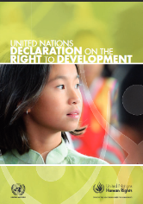
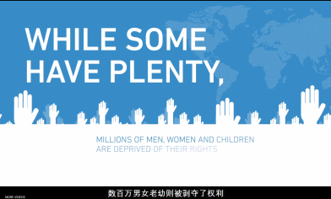
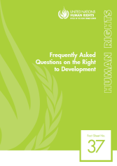
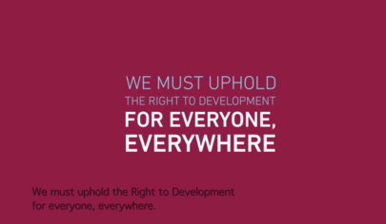
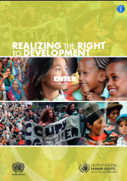
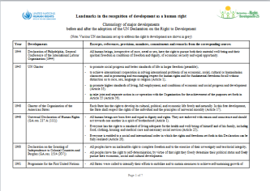
Resource Materials on the
Right to Development
A booklet containing the UN Declaration on the Right to Development
Frequently Asked Questions, OHCHR Fact sheet No. 37
A book – ‘Realizing the Right to Development’
Landmarks in the recognition of development as a human right
Online videos:
Development is a Human Right
The Right to Development for everyone everywhere
All materials are available at:
http://www.ohchr.org/EN/Issues/Development/Pages/InformationMaterials.aspx
http://www.ohchr.org/EN/Issues/Development/Pages/DevelopmentIndex.aspx

Slide 32
Thank you!
Contact
ohchr-r2d@un.org

